Slide 1
Introduction to academic publishing-for researchers doing ecosystem-related research
Julia Jones
Bangor University
Julia.jones@bangor.ac.uk
@juliapgjones
Notes:
AY to start

Slide 2
Thanks
Neal Haddaway
Beth Hall
Martin Fisher
Bruno Ramamonjisoa & ESSA-Fôrets
Debbie Bower
Jonah Ratsimbazafy (GERP)
ESPA
Jeannicq Randrianarisoa (CI)
Notes:
AY to start

Slide 3
Today’s plan
Understanding academic publishing
The peer review process
Getting published
Helping your audience find the paper (self promotion!)

Slide 4
1) Understanding academic publishing -why publish? -the good and bad of open access -selecting the right journal

Slide 5
In groups please discuss for 10 minutes:
1) Why you want to publish
2) Barriers you feel limit your ability to publish in international journals
Nominate someone to feed back to the group

Slide 6
Why do you want to publish in academic journals?

Slide 7
Because the research matters and people need to know the results!
To avoid the research being a waste of resources and time
To synthesise and build consensus about what is known
As a training or academic requirement or requirement of funder
In order to demonstrate impact as a researcher

Slide 8
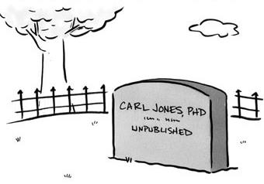
Essential part of career ladder - ‘Publish or Perish’ (quote from Jonah Ratsimbazafy)-certainly true for those wanting international research careers

Slide 9
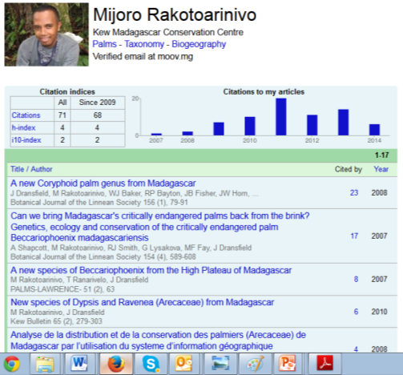
To show how much a researcher publishes- metrics are increasingly used
Could simply report number of papers
OR total number of citations
H index (tries to capture a combination of number of papers and citations of those papers)

Slide 10
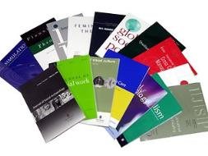
What are the barriers to publishing?

Slide 11
Evidence of barriers to publishing in Madagascar
University of Antananarivo (only Malagasy Uni on list) is 83rd out of 100 top Universities in Africa
There are many excellent, active Malagasy researchers-but much research stays in reports

Slide 12
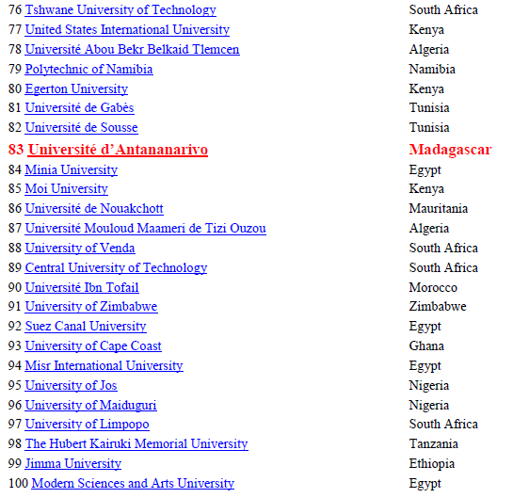
List provided by Prof Ratsimbazafy

Slide 13
The good and bad sides of Open Access
Traditional model: subscription journals
no cost to authors (except colour/extra pages)
readers pay through subscription fees (‘pay wall’)
Good for scientists in Madagascar as no fee to publish BUT
Bad for scientists in Madagascar as you have to pay to access articles (so it is to hard to keep up with the literature)
Open Access: new model (c. 20 years old but growing fast)
readers access articles for free
authors pay publishing fee for each manuscript ALTHOUGH SOME TOTALLY FREE e.g. MCD
Good for scientists in Madagascar as you can easily access articles BUT
Bad for scientists in Madagascar as often hard to get fees to publish

Slide 14
NB Many open access journals (e.g. PLOS ONE) offer reductions or fee waivers for authors from low income countries

Slide 15
Selecting the right journal
Targeting the right audience (who do I want to read it?)
Targeting the right journal (does the journal publish this type of research?)
Targeting for your benefit (where will I get the most impact?)
How to do it
Avoiding predatory journals
Useful resources

Slide 16
Selecting the right journal-audience
Who should read this work?
What does this audience read?
Choose a journal which your desired audience can access!

Slide 17
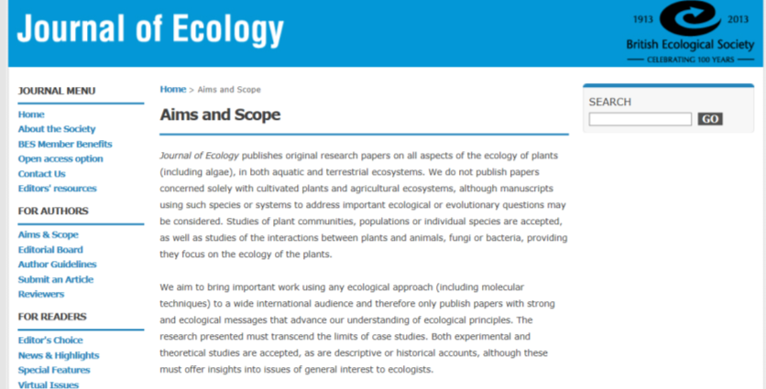
Selecting the right journal: subject/content
Check the details of what articles a journal accepts carefully to avoid wasting time

Slide 18
Selecting the right journal: Impact Factor
Impact factor (the average number of citations an article gets) is often used to rank journals
High impact (>20) e.g. Nature , Science are seen as more prestigious BUT
really excellent journals often have an impact factor of 2-8
Some very good journals publishing valuable research have impact factor of <2 e.g. Oryx,
IF doesn’t account for use of research by policy-makers/practitioners

Slide 19
High impact good for your careers
NB most journals have quite low Ifs
And remember target audience may never see high IF journals

Slide 20
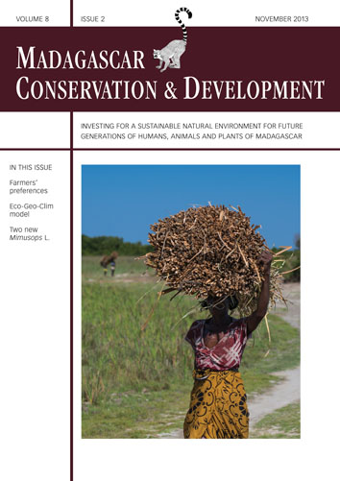

Slide 21
Remember that high IF journals have high rejection rates
Aarssen, L. W., et al. "Bang for your buck: rejection rates and impact factors in ecological journals." Open Ecology Journal 1 (2008): 14-19. http://benthamsciencepublisher.com/open/toecolj/articles/V001/14TOECOLJ.pdf

Slide 22
Selecting the right journal: how
Search Google Scholar for similar research and see where it is published
Familiarity (which journal publishes the research you most frequently read/cite in your work?)
Look at your reference list
Ask advice of colleagues
Read the aims and scope of possible journals

Slide 23
What do other researchers do (from Haddaway in prep)?

Slide 24
Selecting the right journal: avoiding predatory journals
What is a predatory journal?
advent of Open Access means that journals don’t need subscription fees-just need to persuade authors to publish
Predatory journals are driven by income; the more published articles the better
journals will accept poor quality research, very crude peer-review if at all…
publishing in a predatory journal is often viewed as being detrimental to careers

Slide 25
How to spot a predatory journal
Beall’s List is a list of publishers and journals that have been assessed based on key criteria
editorial board not named
no academic information (affiliations etc.) for editorial board
identical editorial boards for different journals
poor/lack of information on publishing processes
no archiving policy (e.g. DOI codes)
journal name mimics an existing, well-respected journal (e.g. adding ‘International’ to title)
See http://scholarlyoa.com/2012/11/30/criteria-for-determining-predatory-open-access-publishers-2nd-edition/ for complete list of criteria

Slide 26
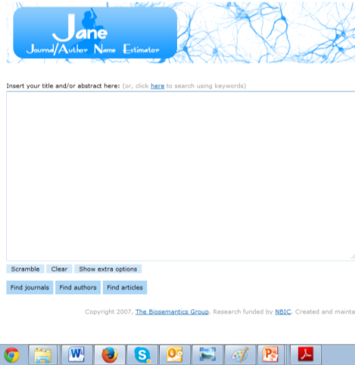
Selecting the right journal: useful resources
JANE (Journal Author Name Estimator)
http://www.biosemantics.org/jane/

Slide 27
2) Understanding the peer review process

Slide 28
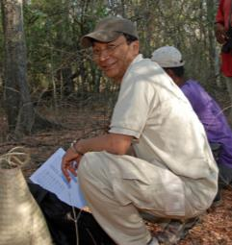
A varying proportion are rejected after review
5%-60% rejected without review

Slide 29
Editor’s decision
Reject (usually on scope)-NB up to 92% for some journals!
Minor revision
Reject but resubmission encouraged (this is a major revision/rewrite/reanalysis)
Accept (usually subject to some minor conditions)

Slide 30
Editor’s decision
Reject (usually on scope)-NB up to 92% for some journals!
Minor revision
Reject but resubmission encouraged (this is a major revision/rewrite/reanalysis)
Accept (usually subject to some minor conditions)
NB 4 is almost unheard of at 1st submission!

Slide 31
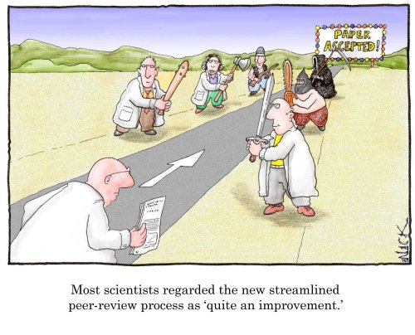

Slide 32
Submission to publication often takes > 1 year
AND can be a painful and fraught process
EXPECT that the hard work is far from over when you submit!

Slide 33
How to respond to decision letter from editor
Write a cover letter where you thank editors and reviewers and include the main changes/improvements you have made
Then a long, detailed document where you respond to each point made by reviewers/editors in turn, showing exactly how you have changed the manuscript
YOU need to do the work for them. Don’t expect them to have to re-read their decision letter and your resubmission to match up changes made!

Slide 34
Great ways to learn about the process
Review for international journals
Join their editorial boards
(NB all such work is unpaid but it is great experience and will help you write papers which get published)

Slide 35
3) Getting published Presented by Debbie Bower

Slide 36
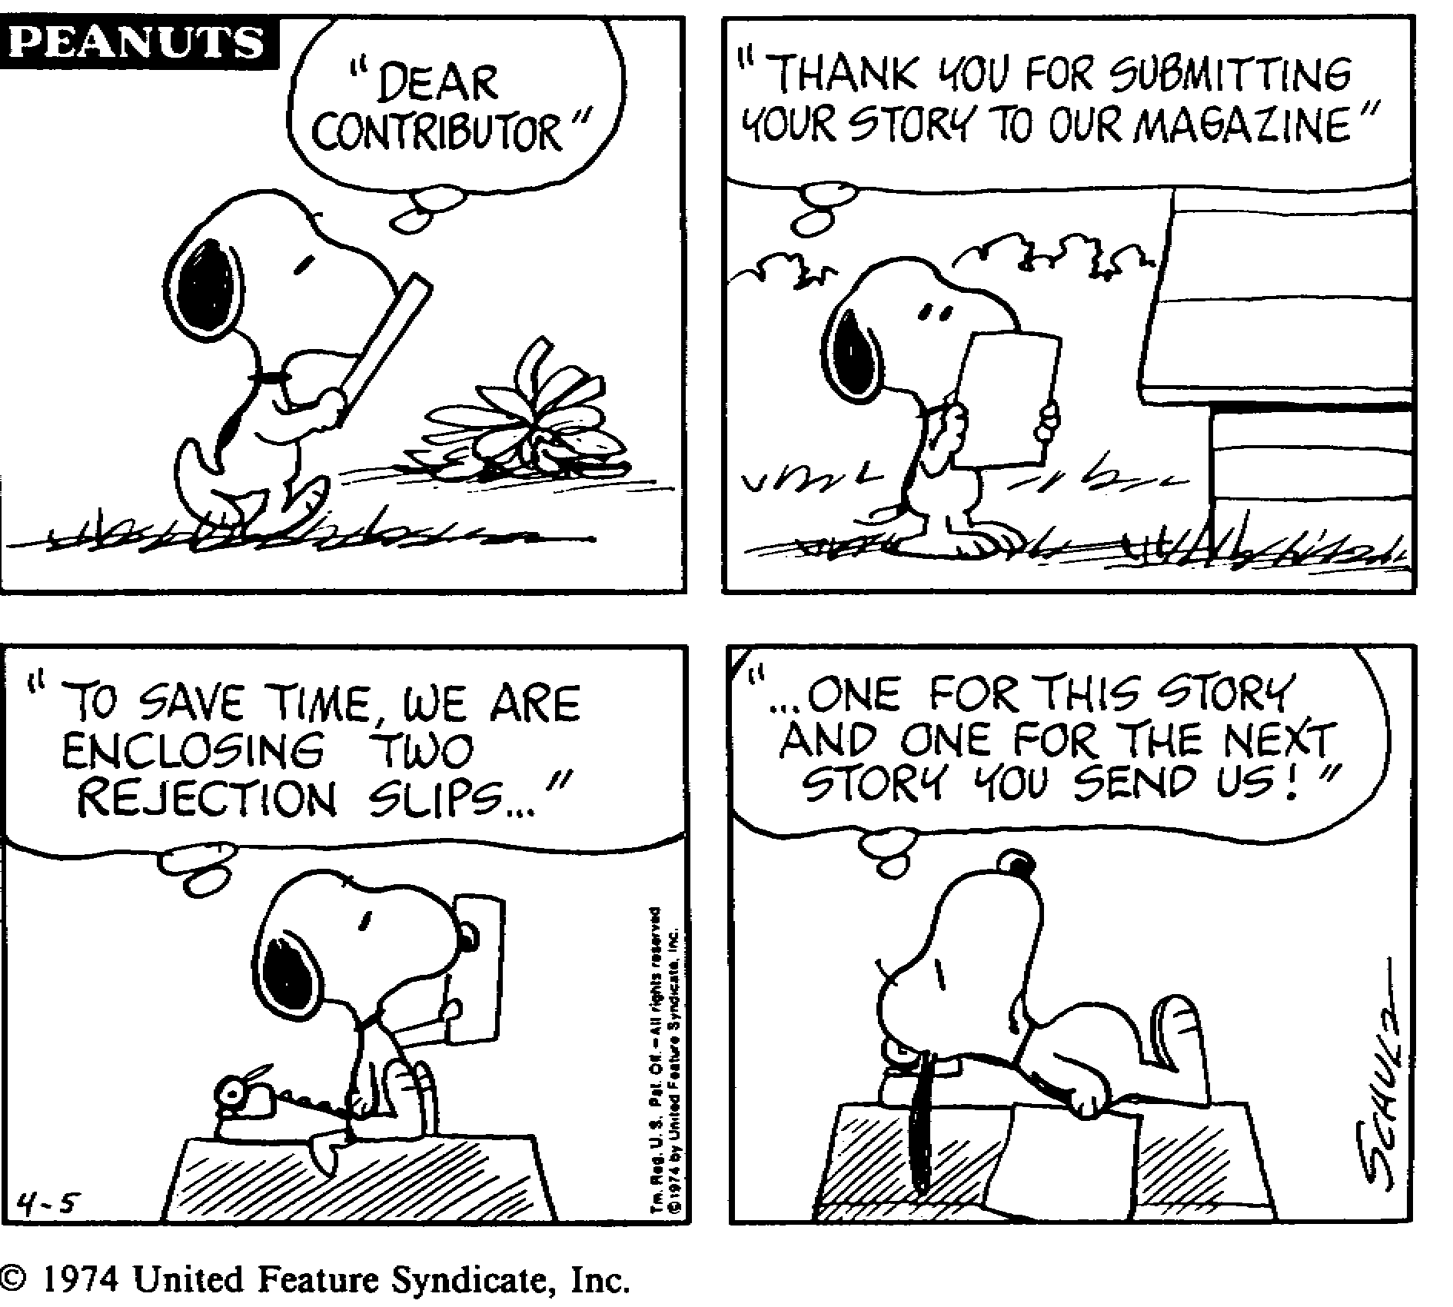

Slide 37
Write backwards….
Step 1) Write the conclusions
Step 2) Write only the results necessary to support the conclusion
Step 3) Write only the methods necessary to understanding how the results where obtained
Step 4) Write the discussion including only additional information (eg literature) that modifies, extends, confirms or contradicts conclusions based on your results
Step 5) Write the introduction which will have only the minimum information necessary to introduce the questions to which the conclusions are the answers

Slide 38
Framing your paper to make it attractive
Lead-in: provide the reader with the context to appreciate significance of your paper
a statement of the problem to be addressed which shows it is a problem worth pursuing
State clear specific objectives: ie what you contribute to the problem introduced
Allude to the major findings/central message to be developed

Slide 39
Framing your paper to make it attractive
‘The infiltration rates of soils in eastern Madagascar have seldom been studied. We provide the first data from eastern Madagascar showing how infiltration depends on land use…..’
‘Soil infiltration is important because it affects the rate at which water reaches rivers (therefore influencing flood risk and dry season flows).In Madagascar, rice farmer’s livelihoods are heavily influenced by flood and dry season drought….’
ie don’t justify importance based on the fact that something isn’t known (there is a lot we don’t know!)

Slide 40
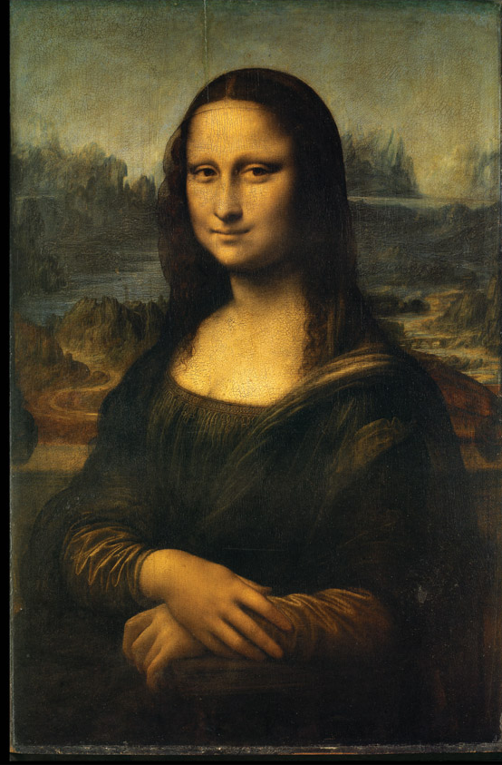
Writing a good abstract
An abstract should be a work of art

Slide 41
Writing a good abstract
1) Motivation/problem statement: Why do we care about the problem? What practical, scientific or theoretical gap is your research filling?
2) Methods/approach: What did you actually do to get your results? (e.g. walked 30 transects, interviewed 750 students, carried out 20 focus groups)
3) Results/findings/product: What did you learn?
4) Conclusion/implications: What are the larger implications of your findings, especially for the problem/gap identified in step 1?

Slide 42
Do your homework!
Make sure you follow guidelines on:
Referencing style
Font size and type, line spacing, page numbering, margin sizes
Word limits
UK vs US English
Standards for abbreviations
Details about how to submit tables and charts e.g. separate sheets, file format, minimum resolution
Copyright declarations
Ethical approval
If a paper is not in accordance with specific journal guidelines, it is likely to be returned unread no matter how interesting the subject matter

Slide 43
Useful resources on writing
http://www.canberra.edu.au/studyskills/writing/introductions
http://abacus.bates.edu/~ganderso/biology/resources/writing/HTWsections.html#abstract

Slide 44
4) Helping the audience find your paper (self-promotion is a good thing here!)

Slide 45
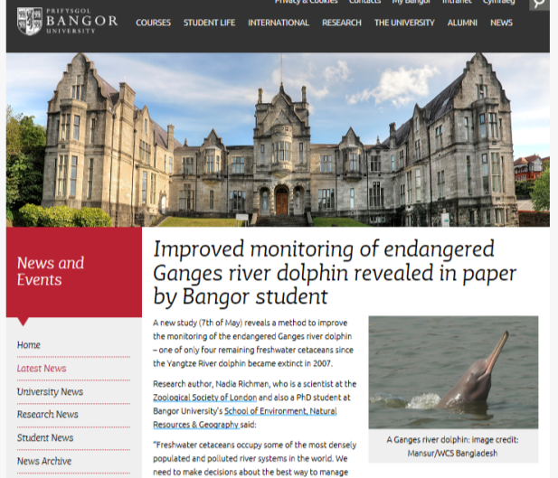
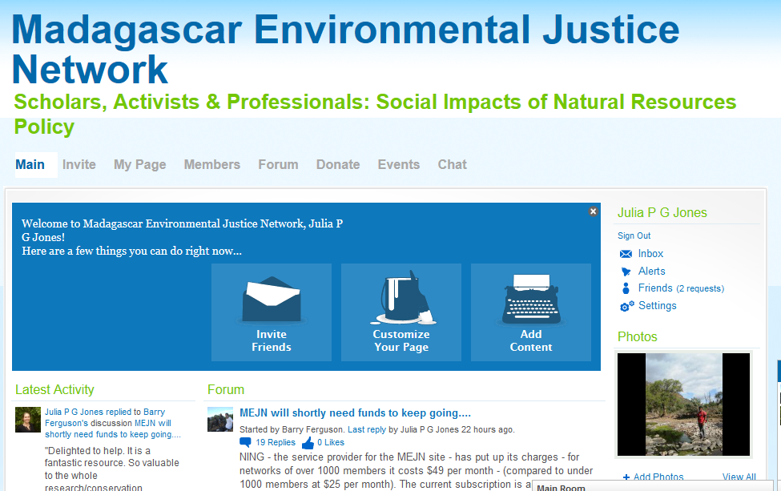
Blogging/post on relevant fora/email people in the field

Slide 46
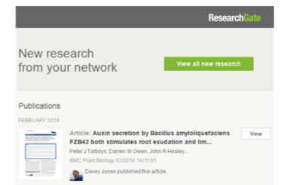
Use social media to publicise publications

Slide 47
Acknowledgements
This seminar drew on material prepared for similar events by Bangor University, Oryx (the International Journal of Conservation), University of Canberra, Newcastle University (Australia)
The accompanying materials include material from Day, R.A. (1994). How to Write and Publish a Scientific Paper. 4th edition. Cambridge University Press. [ISBN 0 521 558980]

