Slide 1
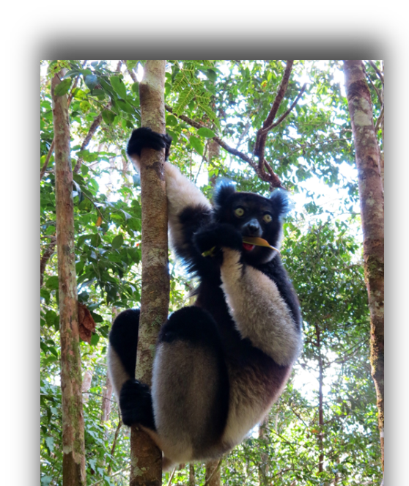
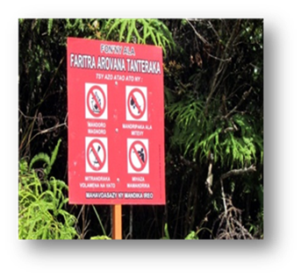
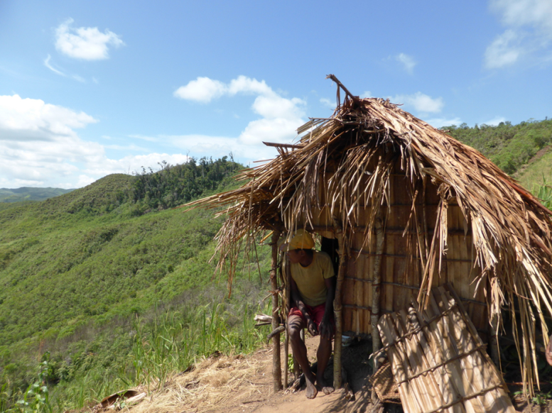
Distributive equity in a protected area safeguard project in Madagascar
Alexandra Rasoamanana, Kate Schreckenberg, Mahesh Poudyal, Julia Jones
CBD COP, Cancun, 13th December, 2016
Notes:
Good afternoon Everyone, I am Alexandra a researcher in p4ges research project conducted in Madagascar. I will be presenting a piece of our work on the costs of protected areas to local people.

Slide 2
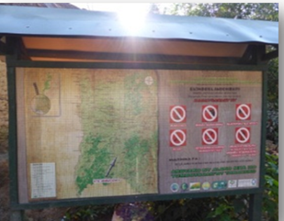
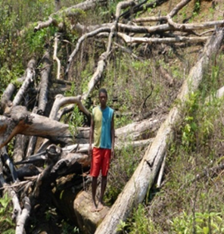
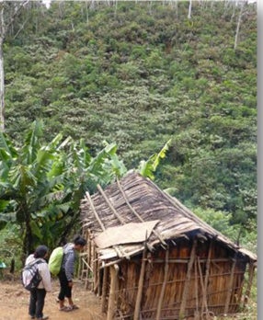
Madagascar’s rapid increase in Protected Areas
2003 IUCN World Parks Congress: President of Madagascar committed to tripling the country’s protected areas.
High biodiversity levels and high poverty levels mean that the expansion of protected areas has received a large amount of external support.
Madagascar represents a good case to explore the distribution of costs and benefits among local stakeholders in a protected area.
CBD COP, Cancun, 13th December, 2016
Notes:
At the IUCN World Parks Congress in 2003 (two thousand and three), the President of Madagascar said he would triple the size of protected areas in Madagascar. The country has therefore seen a major expansion of its protected areas which has received a lot of external support (because of the country has high levels of both biodiversity and poverty). One of the key issues implies by this statement how to ensure that the costs and benefits of the new protected areas are distributed fairly between stakeholders.

Slide 3
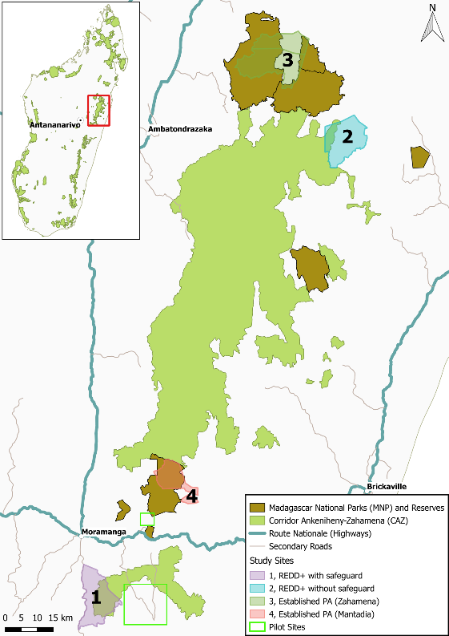
Corridor Ankeniheny-Zahamena (CAZ)
371,000 ha of tropical rainforest in Eastern Madagascar
CAZ was granted formal status as an IUCN Category VI protected area in April 2015
It is co-managed by:
  Conservation International (Park Manager)
  Madagascar National Parks
  Community forest management groups (COBAs) around the edge
Long-term funding will be supported by REDD+
World Bank has supported costs of establishing the protected area
CBD COP, Cancun, 13th December, 2016
Notes:
Our study site is located in eastern of Madagascar, in Corridor Ankeniheny-Zahamena.
This is an area of 371,000 (Three hundred and seventy one thousand) ha – CAZ is one of the largest remaining rainforest in the country.
It is co-managed by three main stakeholders: Conservation International, Madagascar National Parks and many community forest management groups (called COBAs).
The Long-term funding for the area will be supported by REDD+ project and all the establishment costs have been covered by World Bank.

Slide 4
Our research aims
For this case study, we focused our research on distributive equity and the local costs and benefits resulting from the new park
What global and local benefits does CAZ provide?
What are the local costs of the new protected area?
How are households selected for compensation?
How well does compensation cover the opportunity costs of households around CAZ?
CBD COP, Cancun, 13th December, 2016
Notes:
In this study, we focused on distributive equity especially in understanding the local costs and benefits resulting from the establishment of CAZ protected area. Specifically we asked:
What global and local benefits does CAZ provide?
What are the local costs of the new protected area?
How are households selected for compensation?
How well does compensation cover the opportunity costs of households around CAZ?

Slide 5
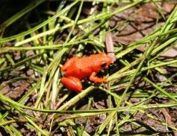
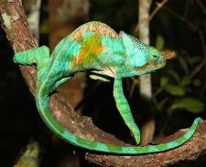
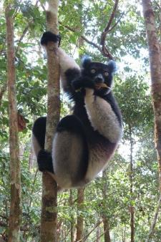
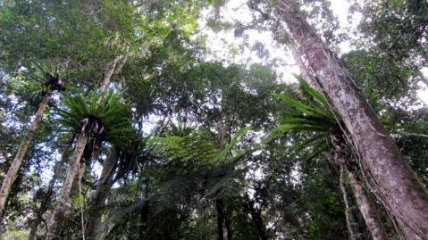
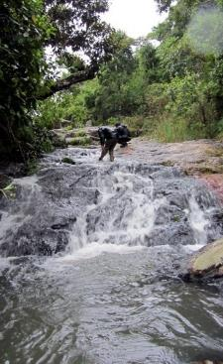
CAZ – what are the global and regional benefits?
Biodiversity:
  Many endemic flora and fauna
  Over 2000 plant species
  15 lemur species
Carbon:
  About 1 million tons of CO2 emissions reduction from avoided deforestation
Water:
  Source of many rivers supporting agriculture and downstream urban areas
CBD COP, Cancun, 13th December, 2016
Notes:
CAZ provides many benefits to global and regional populations:
In terms of Biodiversity: It is home many endemic fauna & flora species, including over 2000 species of plants and 15 Lemur species
About 1 million tons of CO2 emission reduction are achieved through avoided deforestation
It is also home the source of many rivers providing water for agriculture and downstream urban areas

Slide 6
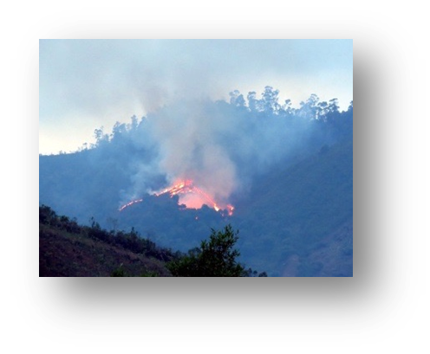
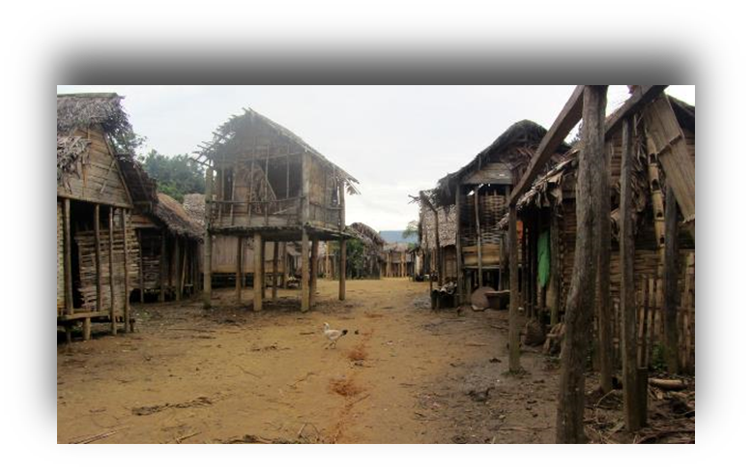
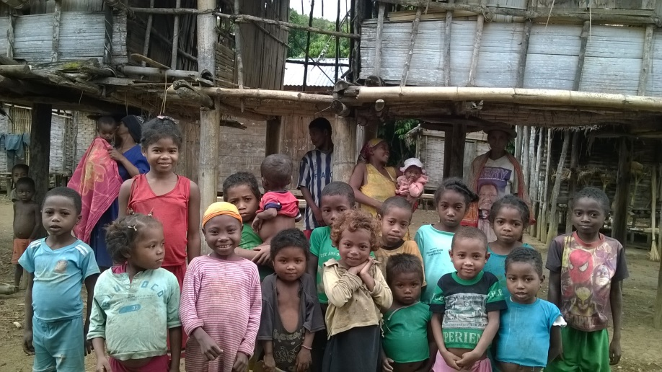
CAZ – local livelihoods
60,000 people live in and around the park
‘Tavy’ shifting cultivation system:
  Hillsides are cleared using fire
  Some paddy rice in the valleys
  Very little livestock
People rely heavily on the forest:
  Firewood
  Construction timber
  Medicines
  Food (plants and bushmeat)
High levels of poverty:
  >90% in ‘extreme poverty’
  Food security (2 good meals/day) typically only for 7 months
  Poor quality housing
  Lack of sanitation
CBD COP, Cancun, 13th December, 2016
Notes:
60,000 (sixty thousand) people live in and around the park.
Their main livelihood activity is shifting cultivation called ‘tavy’. This involves people clearing forest using fire to cultivate rice and other crops.
People rely heavily on the forest for all sorts of forest products as firewood to timber, medicines and food.
The Levels of poverty are very high – about 90 (Ninety)% of people live in ‘extreme’ poverty. People have poor food security and live in poor quality housing with no sanitation.

Slide 7
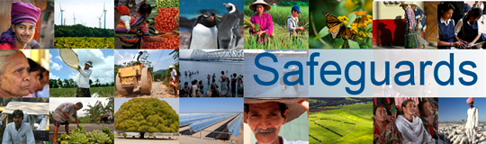
“Do no harm”
http://go.worldbank.org/WTA1ODE7T0
CAZ management wants to stop shifting cultivation, hunting and timber extraction in the park. This will affect local livelihoods
The World Bank’s social safeguards require that all people whose sources of income and standard of living would be negatively affected by the restrictions should be identified as ‘people affected by the project’ (PAPs)
The process of identifying PAPs is supposed to give special consideration to poor and vulnerable groups
An assessment in 2010 identified nearly 2500hh as PAPs of whom 1835 signed ‘letters of engagement to receive compensation’
Compensation was provided in the form of microprojects in 2014
CBD COP, Cancun, 13th December, 2016
Notes:
The main concern for CAZ management is to stop shifting cultivation, hunting and illegal timber and mining extraction in the park. This will affect local livelihoods.
The World Bank’s social safeguards require that all people who are affected by the restrictions should be identified as ‘people affected by the project’ or PAPs.
The process of identifying PAPS is supposed to give special consideration to the poor and vulnerable groups who are generally likely to be marginalised in the society.
The World-Bank funded the process to identify PAPs in 2010 (two thousand and ten) and identified nearly 2500 (two thousand and five hundred) households. With the update list 1835 Households (One thousand and Eight Thrity Five Hundred) signed ‘letters of engagement’ to receive compensation.
Compensation was delivered in the form of individual microprojects in 2014 (two thousand and fourteen).

Slide 8
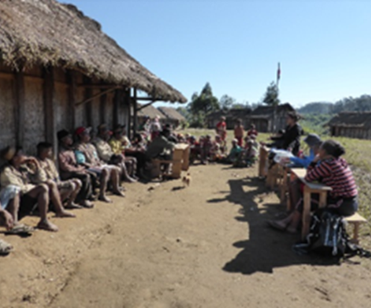
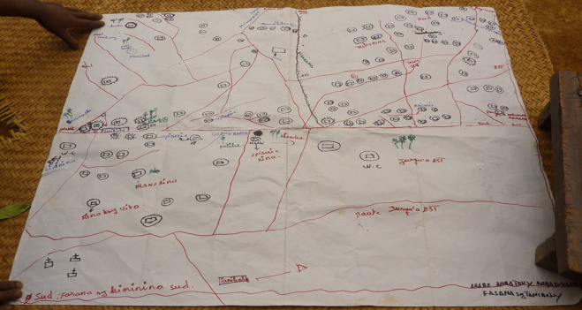
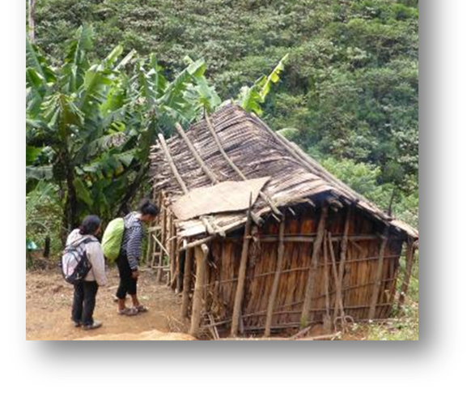
Who was identified as a PAP?
Methods
We worked in one safeguard site (Ampahitra) in the south-west of CAZ
We collected a list of all households (417) scattered in 8 villages at the site.
We randomly sampled 203 hh
We used a structured survey questionnaire to collect data on demographic characteristics and livelihood activities, and asked whether the hh had been identified as a PAP
CBD COP, Cancun, 13th December, 2016
Notes:
We worked in one safeguard site (Ampahitra) in the south-west of CAZ
We collected a list of all households (in total 417 Four Hundred and seventeen) scattered across 8 villages living next boundary and inside the protected area. This was a long process as there was no formal list and most of the villages were not on any official maps.
We randomly sampled 203 (two hundred and three) hh.
We used a structured survey questionnaire to collect data on demographic characteristics and livelihood activities and asked whether the hh had been identified as a PAP or not.

Slide 9
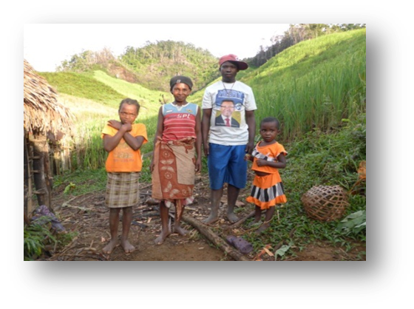
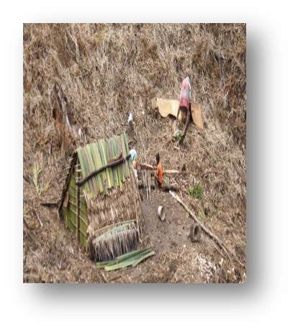
Who was identified as a PAP?
Results
141 hh had been in the area in 2010 – only 36 of these were identified as PAPs.
Key factors which influence the likelihood of being identified as a PAP were:
  Having a household member in the COBA, and preferably in a decision-making position (like chairperson or secretary)
  Having higher food security
  Living closer to a motorable road
CBD COP, Cancun, 13th December, 2016
Notes:
We found that Only 141 (one hundred forty one) households had been in the area at the time of the PAP assessment. Of these households, we found that 36 (thirty six) had been identified as PAPs.
After comparing the PAP with non-PAP, these are the Key factors which influence the likelihood of being identified as a PAP were:
Having a household member in the COBA, and preferably in a decision-making position (like chairperson or secretary)
Having higher food security
Living closer to a motorable road

Slide 10
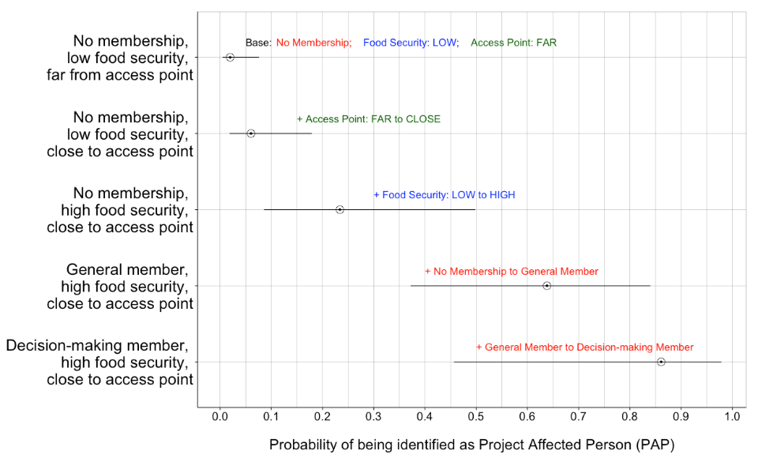
Impacts of Access, Food Security, and COBA Membership on PAP Identification
HHs with decision-making member (in COBA), high food security & close to access point are >20 x more likely to be identified as PAPs compared to those without membership, low food security & far from access point
CBD COP, Cancun, 13th December, 2016
Notes:
We also analysed the marginal effect of each of these factors on the probability of the household being identified as PAP. Our results show that a household with a decision-making member in the local forest management association, high food security, and close to the access point were over twenty times more likely to be identified as PAPs than those without membership in the local forest management association, low food security and far from access point.

Slide 11
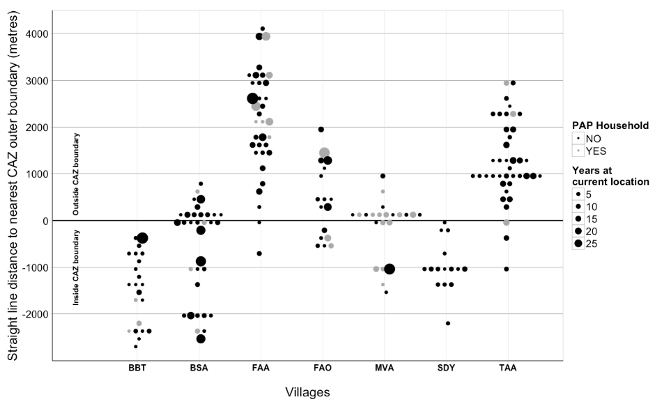
Many households (and an entire community) were not identified as beneficiaries of the safeguard project
Outside PA boundary
Inside CAZ boundary
CBD COP, Cancun, 13th December, 2016
Notes:
On this graph, each dot represents a household. The size of the dot indicates how long the hh has been established at the location. Black dots are households who were not identified as PAPs. The graph shows that there are many hh, including many who have been long established inside the park, who were not identified as PAPs. Indeed, there was one village that was completely missed by the assessment.

Slide 12
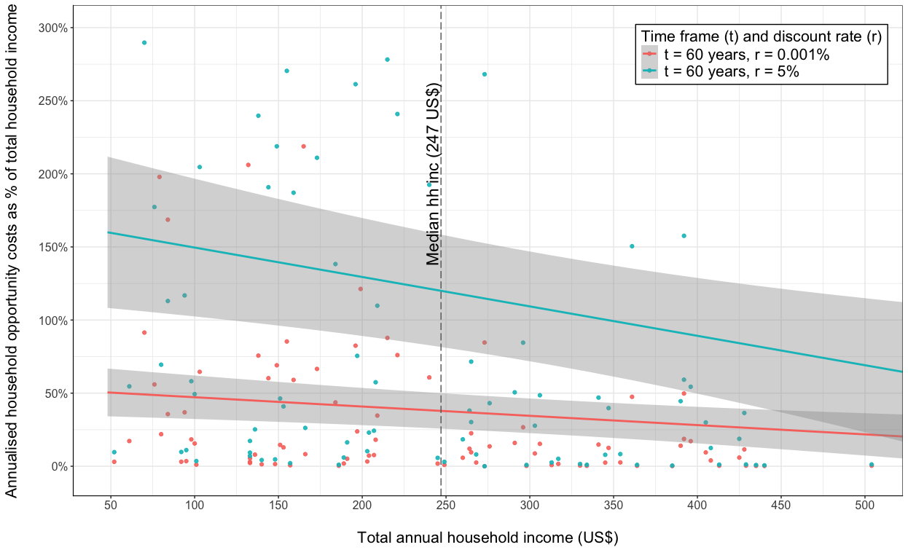
Estimated opportunity costs vs total household income
Safeguards assessment: loss/hh ~ US $120/year
Our Estimation (r: 5%, t: 60 years,) loss/hh ~ US $180/year
Around 1800 households identified to receive compensation
Only 853 households (<50%) have actually received compensation (WB 2015)
Median NPV of Opportunity Costs Estimated:
US $2500 /hh
Only 50% of the potentially eligible households in/around CAZ protected area officially identified for safeguards compensation
Less than 25% of the potentially eligible households have received compensation
CBD COP, Cancun, 13th December, 2016
Notes:
After looking at this identification process, we took the whole of CAZ Household income to estimate the opportunity cost of protected area to local communties. The median net present value of opportunity costs indicate 2500 (Two thousand and five hundred) in US $per household.
We then compared the estimated opportunity costs, annualised using a 60-year timeframe and various discount rates, to total annual household incomes. As a percentage of total annual household income (with the year 2014), the opportunity costs ranged from 40%-120% for the median-income household on average. Of course the distribution shows some households bear almost no opportunity costs, however, higher proportion of such households are relatively well-off for the given context. In overall, the poorer households bear much higher opportunity costs as a percentage of their annual household incomes than richer households. This is true for all time frames and discount rate combinations.
If we look at the safeguards assessment, we find that their estimated loss per household of US $120 per year is very close to our estimates. However, they identified only around 1800 households to receive compensation, and of those only 853 have received compensation according to the World Bank’s project implementation and completion report.
Based on our estimation, we believe only 50% of the potentially eligible households in and around CAZ were officially identified for safeguards compensation.
And less than 25% of the potentially eligible households have actually received compensation.

Slide 13
Local costs of conservation are significant:
US $2500 x 3000-4000 HHs = about US$ 7-10million
Compensation is inadequate:
US $120 x 1800 HHs = < US$ 0.25 million
CBD COP, Cancun, 13th December, 2016
Notes:
So, taking the whole CAZ area together, local costs of conservation are significant. Based on our estimated net present value of the opportunity costs per household which is (two thousand and five hundred US Dollars) $2500 and we estimated around 3000-4000 (Three to four thousand) are households potentially eligible for compensation, the total cost locally from the establishment of CAZ is about $7-10 million (US dollars).
However, actual one-time compensation is only about $ (one hundred twenty Us dollars ) 120 per household for about 1800 (One thousand and eight Hundrerd) households, totalling less than a quarter of a million US$.

Slide 14
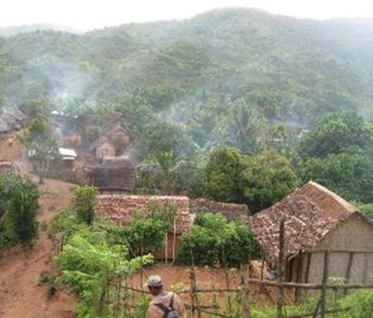
Recognition: Who is recognised as being affected by the protected area?
Several villages are inside the park
Recognised by development actors, like the commune and CISCO (primary schools)
Not recognised by environmental actors like park management
  Not formally eligible for compensation initiatives
  Not properly included in any discussions about park management
CBD COP, Cancun, 13th December, 2016
Notes:
As discussion according to who should be compensated or not, I have already mentioned that some villages were entirely inside the park. These have an odd status – they are recognised by development actors and have official primary schools. But they are not recognised by environmental actors. This means that they are not formally eligible for compensation and are not properly included in discussions about the park management.

Slide 15
Procedural equity
The safeguard assessment process showed systematic bias (Poudyal et al. 2016), due to
  local elite capture
  assessors targeting easily accessible areas
  poor information on local communities
Process for discussing level and type of compensation was not considered fair
  Very few compensation options were on offer (e.g. rice or bean farming techniques, beekeeping, poultry, fish ponds) which some people felt did not respond to their real needs…….
  ……but “if you are offered a gift you don't refuse it”.
CBD COP, Cancun, 13th December, 2016
Notes:
The study raises two issues of procedural equity.
First, the safeguard assessment was systematically biased. This was due to local elite capture, assessors targeting easily accessible areas, and poor information available on the local communities.
Second, the process for discussing the type and level of compensation was not considered to be fair. The PAP households were only offered very few types of microproject as compensation. These included improved rice and bean farming techniques, beekeeping, poultry and fish ponds. Many people felt these did not respond to their needs but said that ‘if you are offered a gift, you don’t refuse it’.

Slide 16
Conclusions
Protected areas like CAZ provide great’ global benefits.
But they can impose high costs on local people.
Social safeguards are an important means of compensating people affected by protected areas.
A greater emphasis on recognition and effective procedural equity could ensure fairer distributive outcomes.
CBD COP, Cancun, 13th December, 2016
Notes:
Protected areas like CAZ provide great’ global benefits.
But they can impose high costs on local people.
Social safeguards are an important means of compensating people affected by protected areas.
A greater emphasis on recognition and effective procedural equity could ensure fairer distributive outcomes.

Slide 17
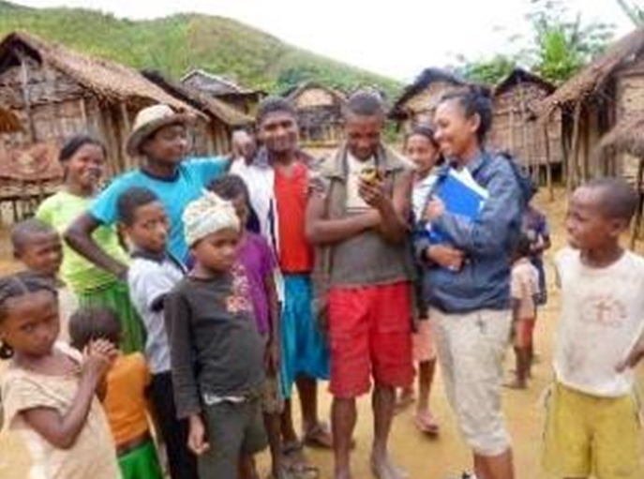


Thank you!
Further Information
p4ges.org
@P4GES
M. Poudyal, B.S. Ramamonjisoa, N. Hockley, O.S. Rakotonarivo, J.M. Gibbons, R. Mandimbiniaina, A. Rasoamanana, J.P.G. Jones (2016) "Can REDD+ social safeguards reach the ‘right’ people? Lessons from Madagascar", Global Environmental Change 37: 31-42.
M. Poudyal, B.S. Ramamonjisoa, O.S. Rakotonarivo, N.S. Andrianantenaina, N. Hockley, J.M. Gibbons, R. Mandimbiniaina, A. Rasoamanana, J.P.G. Jones (in Prep.) “Who bears the cost of forest conservation?”
CBD COP, Cancun, 13th December, 2016
Notes:
That is the end of my presentation and Thank you so for your attention.
For further information please visite our website and you can follow us on twitter

