Slide 1
Welcome
11th September 2015
Julia Jones Bangor University

Slide 2
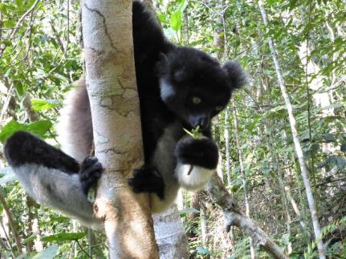
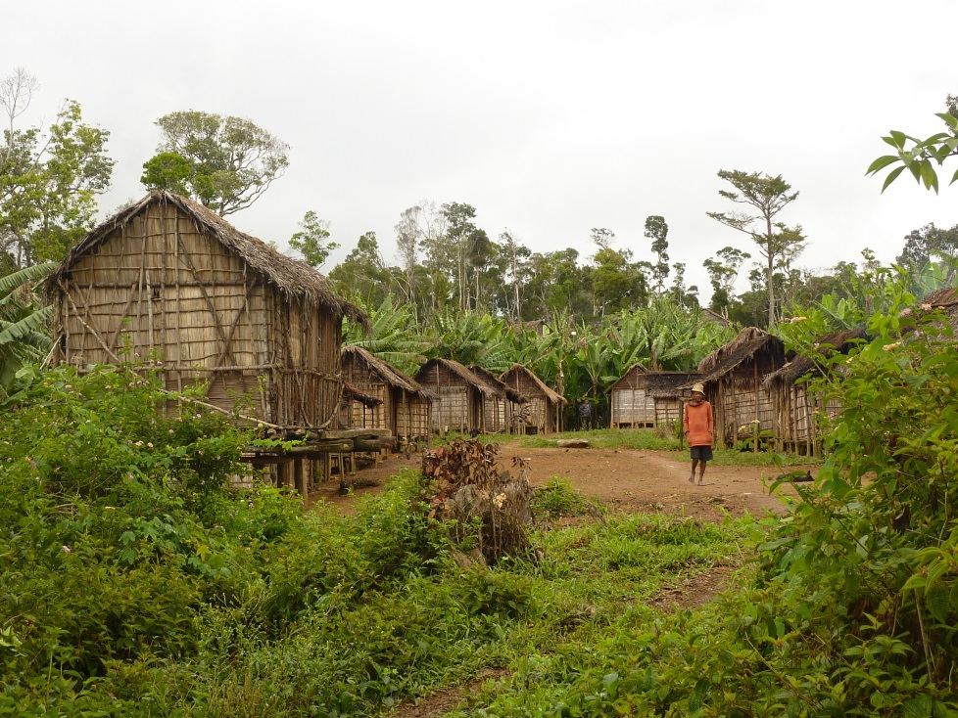
There has been a big change in approaches to forest conservation over the last decades
There is now recognition that full consideration of the impacts of conservation on local welfare is needed
Our project p4ges comes firmly from that perspective
Notes:
NB presentation in Gasy and French with English slides

Slide 3
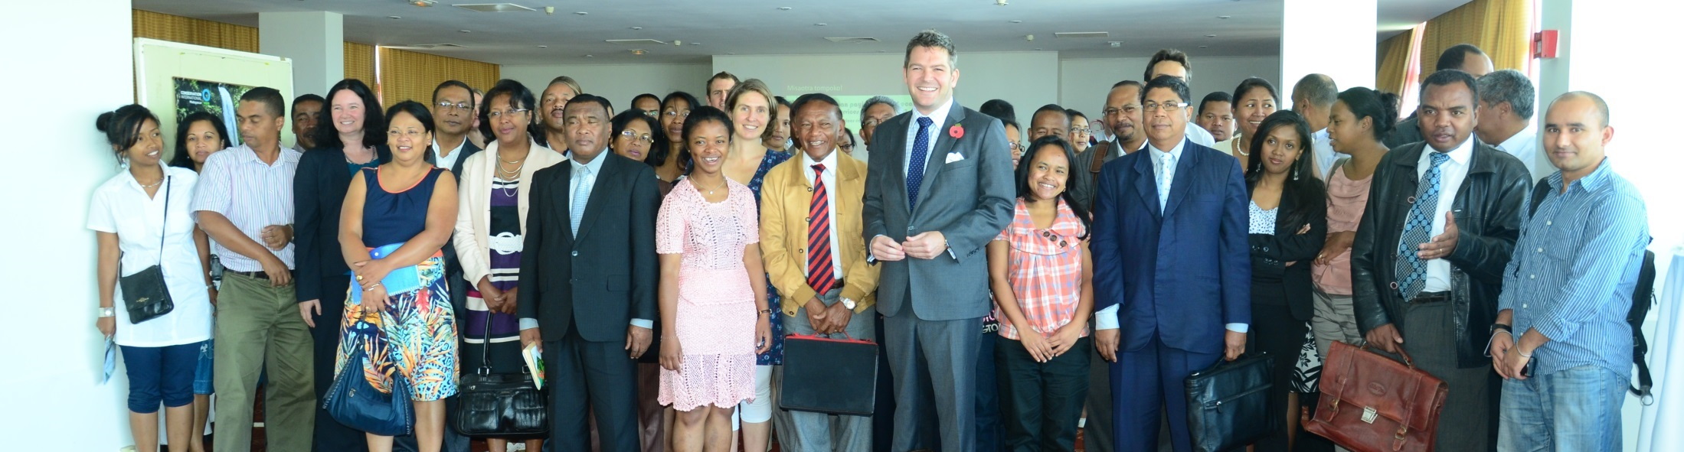
P4ges was launched in November 2013 (many of you attended)
We aim to increase knowledge of how globally and locally valued ecosystem services are affected by land use change

Slide 4
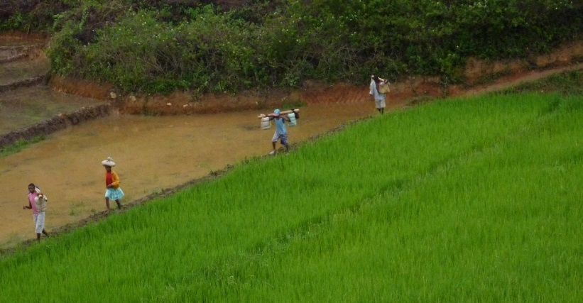
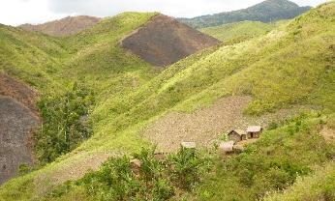
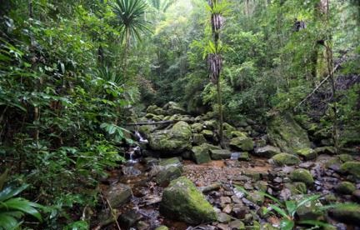
REDD+ (Réduction des émissions dues à la déforestation et à la dégradation des forêts) is a climate mechanism BUT there are concerns about how it will impact local livelihoods
We are exploring how REDD+ can be best designed to have a positive impact on poverty

Slide 5

Our funders (and all us researchers) really care that the results are not left to rot in papers and reports but can be used by those making decisions about REDD+, land use & land management in Madagascar
We invited you here today so you can help us make that happen

Slide 6
Introduction to the p4ges project and introduction to the day
Bruno Ramamonjisoa (ESSA, University of Antananarivo)

Slide 7
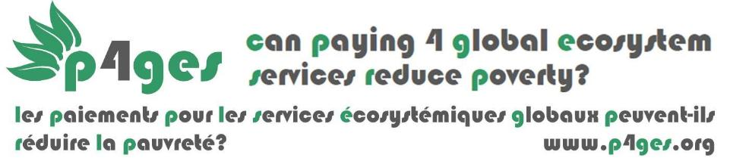
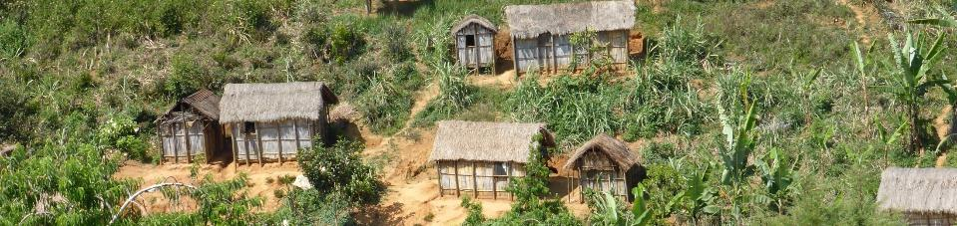
p4ges veut améliorer la compréhension comment l’utilisation des terres affecte-t-elle les services fournis par l’écosystème (à la fois local et global) ET fournir les information pour aider les projets comme le REDD+ afin de contribuer à la réduction de la pauvreté

Slide 8
Notes:
avoided deforestation/forest restoration and biodiversity conservation (though REDD+ or other forest conservation funding) can change the relative amounts of different land uses in the landscape (forest, savoka. tany maty, agricultural land)
REDD+ can influence the welfare of local people (at the forest frontier) in two ways:
1) Though

Slide 9


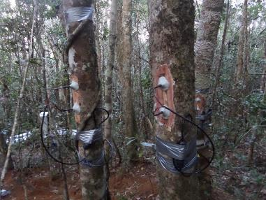


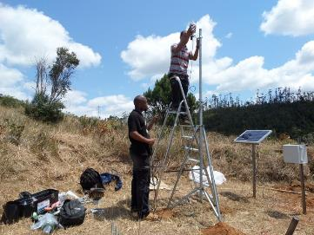
Recherche sur l’hydrologie (façon empirique et par modelisation)
Notes:
We are looking at how different land uses affect the water available for agriculture and risk of flooding (see presentation by Maafaka)

Slide 10

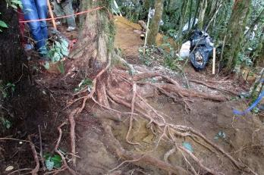
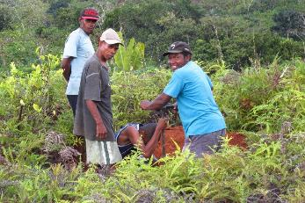


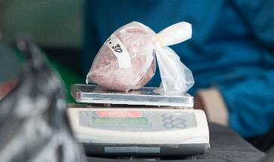




Recherche sur le carbone (façon empirique et par modelisation)
Notes:
We are looking at how different land uses contribute to carbon storage (thus slowing climate change)

Slide 11
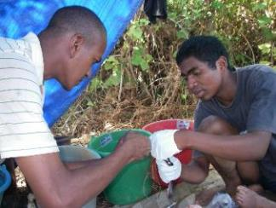
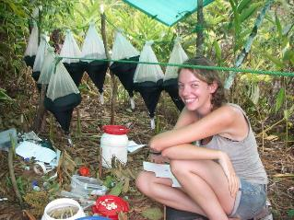


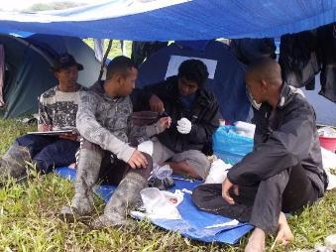
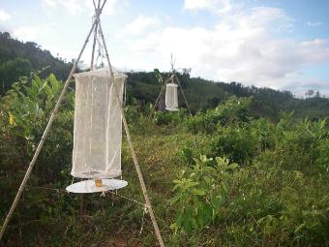
Recherche sur la biodiversité
Notes:
We are looking to see how different land uses influence how many of Madagascar’s rare species are present

Slide 12
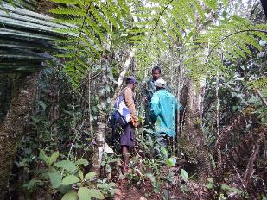

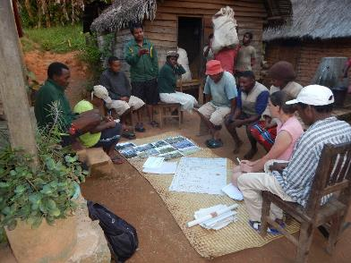
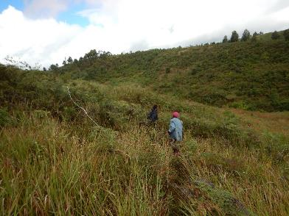
Recherche sur la collecte des ressources sauvages
Notes:
We are looking at how different land uses affect the availibity of locally valued wild harvested products (such as weaving materials, food, medecines etc)

Slide 13

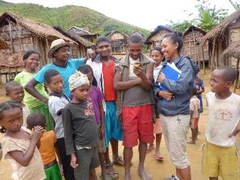
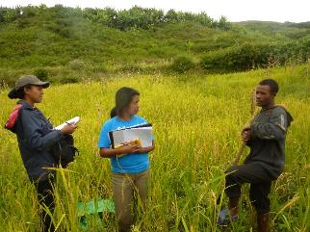


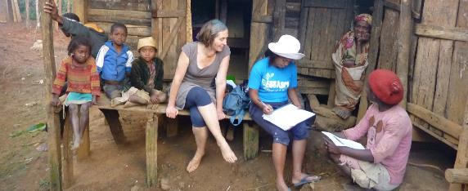
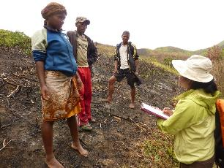
Recherche sur les coûts locaux et les bénéfices de la conservation
Notes:
We are looking at how conservation projects can bring costs and benefist for local people and how these are distributed

Slide 14
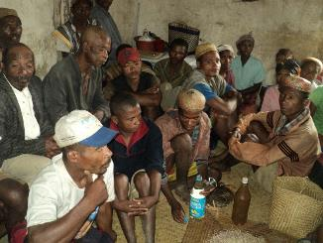

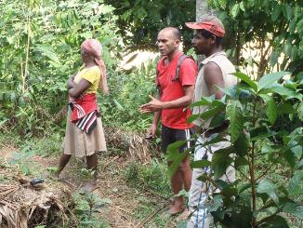
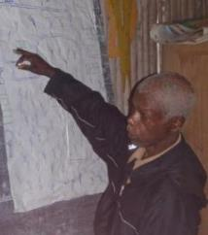
Recherche sur les rôles des institutions locales dans la prise de décisions sur l’utilisation des terres et la distribution des bénéfices du projet
Notes:
We are looking at the role that local institutions play in making decisions about land use and distributing benefits from projects

Slide 15
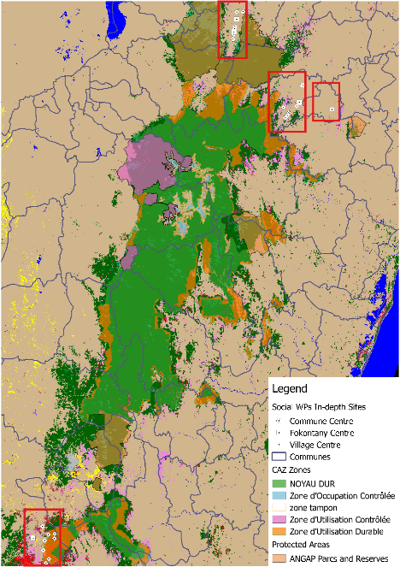
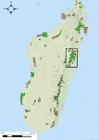
Antevibe - Ambodivoangy
Sites d’étude
Sahavazina
Amporoforo
ZOI 4
ZOI 3
ZOI 2
Mantadia (
Ampahitra
ZOI 1
Notes:
We work in many places around the corridor. Biophysical work is in yellow and social research is in red on this map. We have a special focus around Andasibe (for the hydrological research)

Slide 16
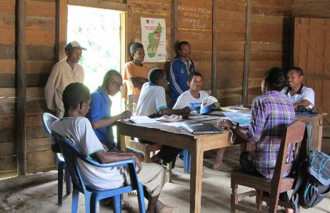
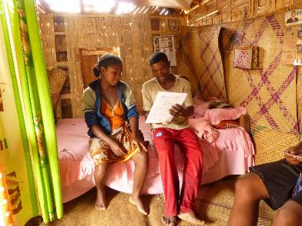
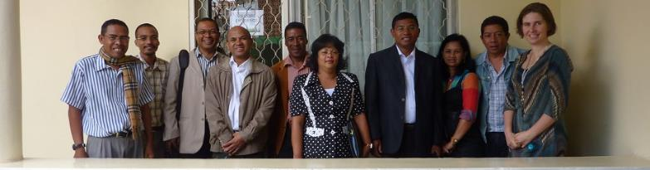
Comment travaillons-nous ?
Notes:
We aim to explain our research really well locally so it is well understood (by authorities and also local people)
We aim to be transparent, to reduce any local worries eg we carry leaflets with our names, photos, contact detail of the project authority in Madagascar
We work closely with the national authorities and have an advisory board who advise us
Today is part of this-we don’t want to keep any part of our research hidden but we wish to share it with you. We hope you consider it useful and if you have suggestions about how it can be most useful and of other presentations we should give etc then please let us know.

Slide 17




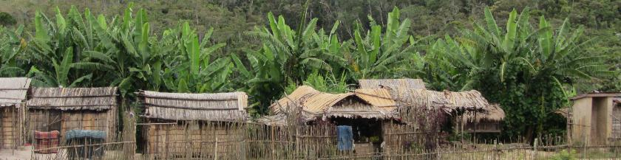
Can REDD+ social safeguards reach the ‘right’ people?
Mahesh Poudyal, Bruno S. Ramamonjisoa, Alexandra Rasoamanana, Rina Mandimbiniaina, James Gibbons, Neal J. Hockley, Sarobidy Rakotonarivo, Julia P.G. Jones
@juliapgjones, julia.jones@bangor.ac.uk, www.p4ges.org

Slide 18



Social safeguards in REDD+ (Reducing Emissions from Deforestation and Degradation)
Aims to ensure that people are not harmed or made worse off by REDD+ activities: recent commitments BUT criticism that planned provision is weak
Social safeguards are not new-many donors have their own social safeguard procedures in place e.g. World Bank identifies Project Affected Persons (PAP) for compensation

Slide 19
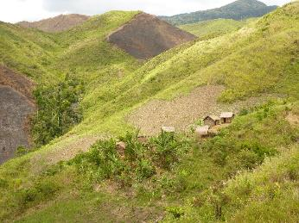

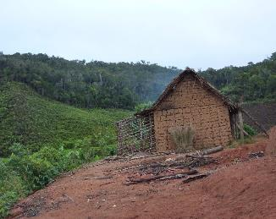
Our Aim: to compare characteristics of households identified as PAPs with a random sample of households in the area
(to explore characteristics which make it more or less likely for households to be identified as eligible for compensation under safeguards)

Slide 20
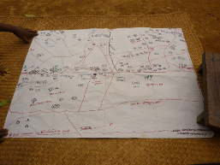
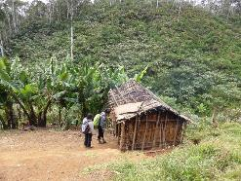
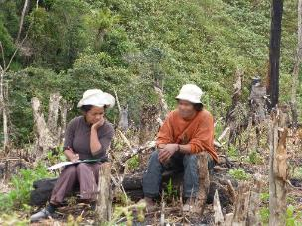
Methods (NB this was done in Ampahitra)
Constructing a sampling frame (33% of field time!)
Sketch maps with key informants to identify villages
Visiting each village/hamlet to map location
417 households identified
Household interviews with stratified random sample (203)
39 had been identified as PAPs

Slide 21
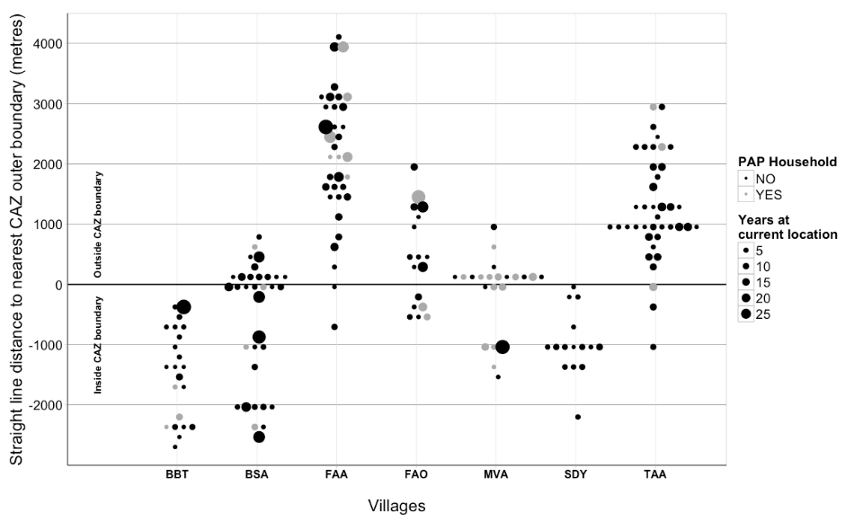
Results
There are many households (including those long established) which were not identified as eligible for safeguards
Outside PA boundary
Inside CAZ boundary

Slide 22
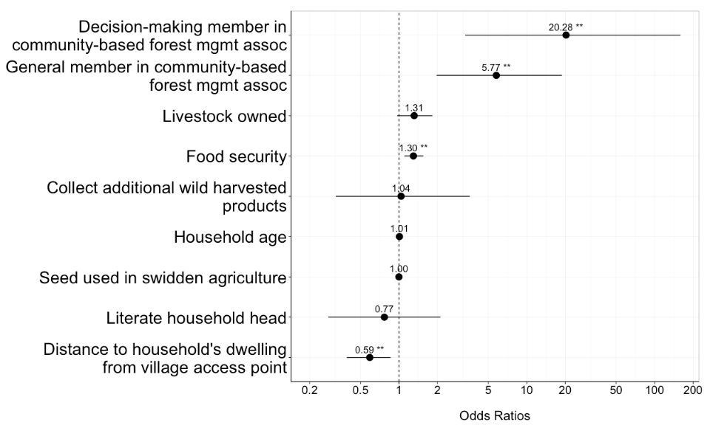
Which factors influence the likelihood of being identified as a PAP?
+ve influence
-ve influence

Slide 23
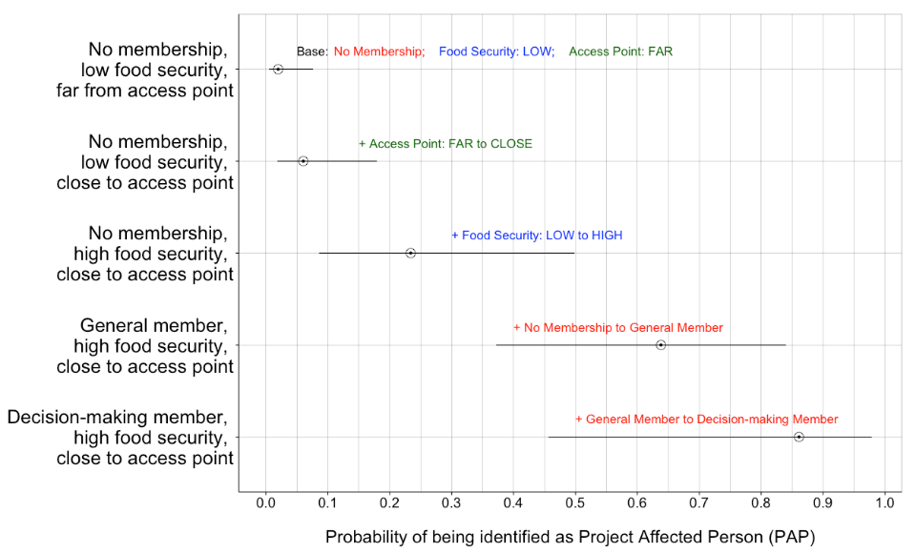
Impacts of Access, Food Security, and COBA Membership on PAP Identification

Slide 24
Impacts of Access, Food Security, and COBA Membership on PAP Identification
Notes:
A person with no coba membership, low food security and living far from access points has only 5% chance of being identified as a PAP whereas someone with high food security, living close to the access point and a decision making member of the COBA has an 85%chance of being identified.

Slide 25
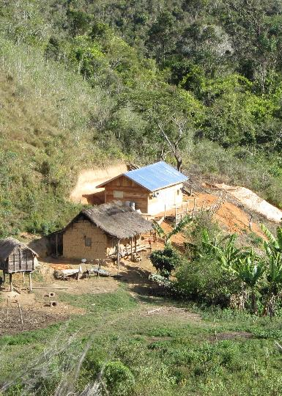
Key Findings
Many HHs likely to be affected by the project were not identified as PAPs, and this appears to be a systematic bias in safeguard assessments process due to local elite capture
This would be very difficult to avoid due to:
A) poor information on the location of population and
B) unwillingness to ‘self-identify’

Slide 26
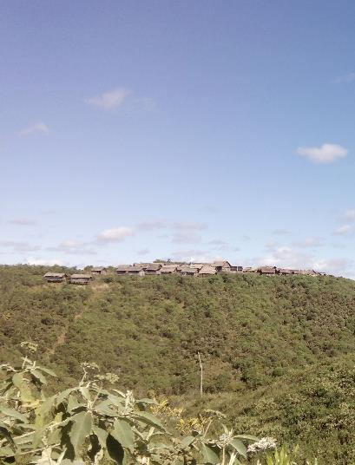
Policy Implication
An effective social safeguard assessment to identify individual households affected by a REDD+ project may not be practical (or cost-effective) in settings with poor information on local populations and challenging access.
Blanket compensation of all households may be the optimal solution.

