Slide 1













La recherche hydrologique de p4ges
26th March 2015
Notes:
This presentation will focus on the hydrological research of the p4gest project. We will see some of this research during the field trip later today

Slide 2
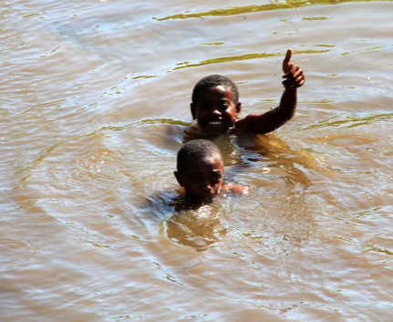
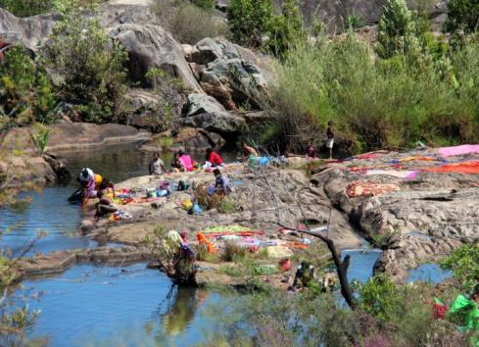
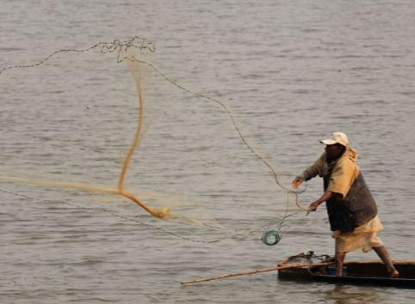
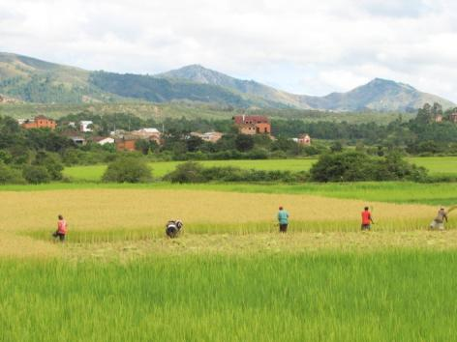
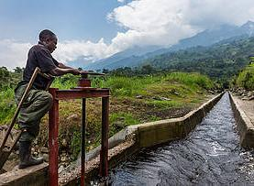
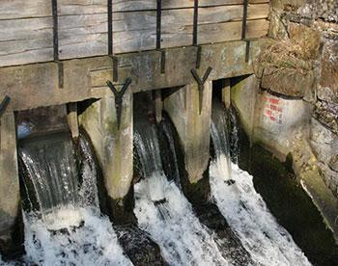
L’importance de l’eau dans la vie humaine
Utilisation de l'eau des ménages et de la santé
la pêche
hydroélectricité
irrigation
Notes:
Water is important for everyday activities such as washing and fishing. It is also very important for irrigation and hydropower. If there is not enough streamflow during dry periods, this will negatively impact rice production and power generation

Slide 3
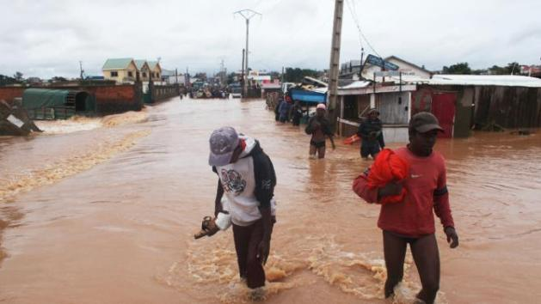
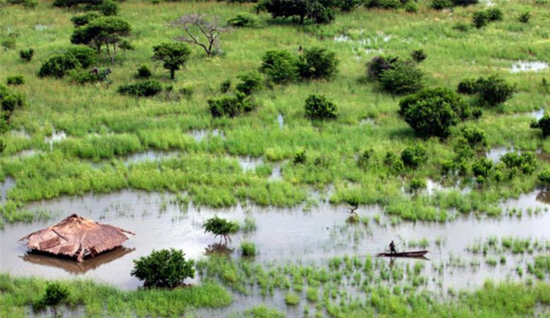
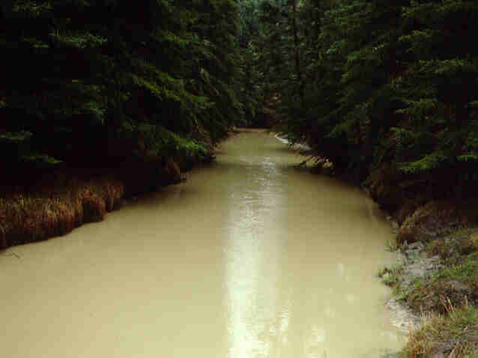
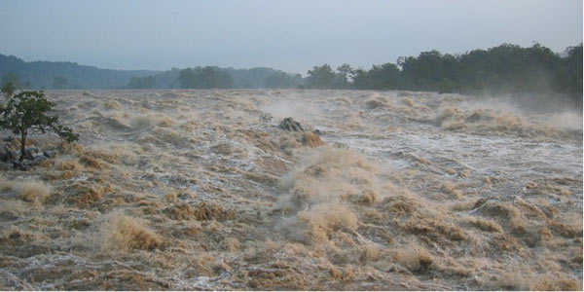
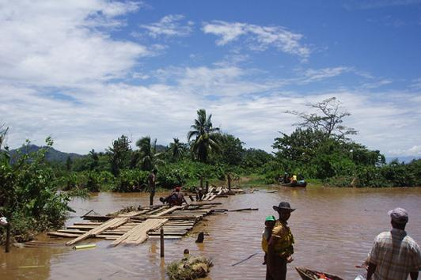
Les dangers de l’eau pour la vie humaine
Notes:
On the other hand if there is too much streamflow (flooding) then this also negetively impacts livilihoods as it leads to damage to crops, houses, roads, etc

Slide 4

Mars 22: Journée Mondiale de l’eau:
Le thème de 2015 : Eau et Développement Durable
L’eau est liée au développement de toutes les sociétés et cultures
L’eau est au cœur des trois dimensions du développement durable:
  Économique
  Sociale
  Environnementale
Notes:
Last Sunday, March 22nd, was World Water day. The theme for this year was water and sustainable development as water is central to economic, social and environmental aspects of sustainable development

Slide 5

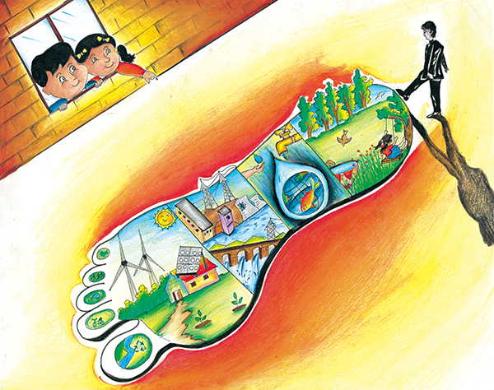
L’eau est la clé pour accomplir:
  Réduction de la pauvreté
  Croissance inclusive
  Santé publique
  Sécurité alimentaire
  Vies de dignité pour tous
  Une harmonie de longue durée avec les écosystèmes essentiels de la terre
5è Lauréat du Prix Mondial Khushne et Bhatia 10 Years, India PNUE, 21è Compétition Internationale de Peinture d’ Enfants Photo Gallérie
Notes:
Water is important for:

Slide 6

Journée Mondiale de l’eau:
L’eau permet des connections
L'eau est essentielle, limitée et vulnérable
L'eau est un moteur de développement et favorise:
  La santé
  La nature
  L’ urbanisation
  L’ industrie
  L’ énergie
  La nourriture
  L’ égalité
Notes:
World water day focused on water as the motor for:

Slide 7
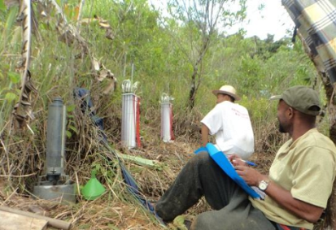
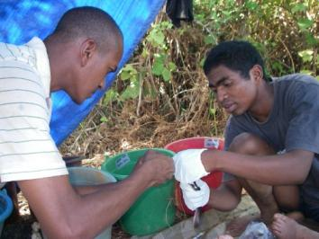
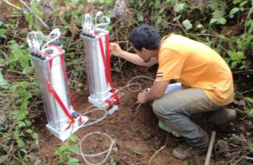
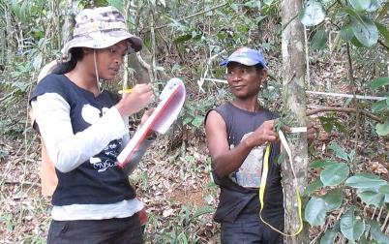
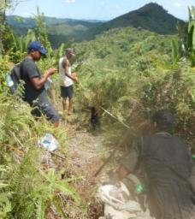
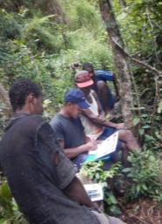
Une partie de la recherche dans le vaste projet p4ges
  Recherche integrée de la biophysique: questions clées
  Comment le processus de dégradation et de restauration affecte-t-il la fonction hydrologique, le stock de carbone, la biodiversité et la collecte de produits sauvages dans les différentes utilisation du sol?
  Comment peut-on optimiser la recherche hydrologique dans la déforestation évitée/la restoration au service de services écosystémiques?
Fonction hydrologique
Biodiversité
Disponibilité des produits sauvages récoltés
Carbon
Notes:
All of this work is part of the larger p4ges project. The hydrology work is part of the integrated biophysical work. The other biophysical teams focus on biodiversity, carbon and the availability of wild harvested products. The biophysical teams aim to answer the following research questions:

Slide 8
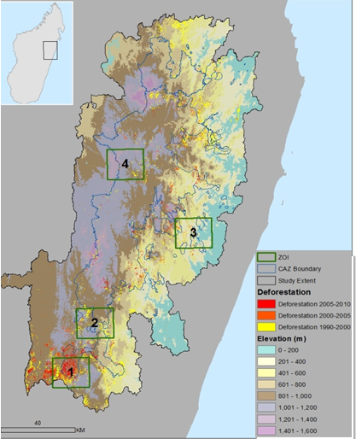
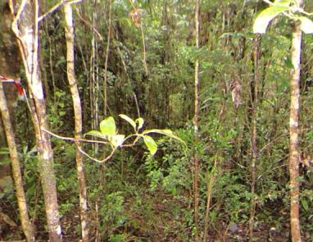
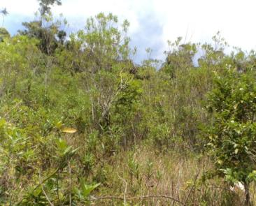
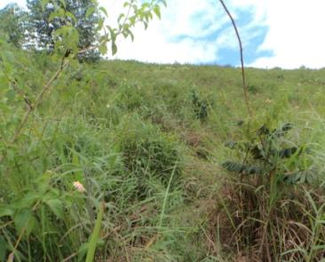
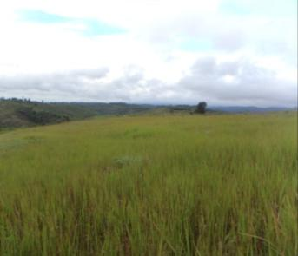
Collecte integrée de données biophysiques
Mesures de 4 utilisations de sols:
  Forêt primaire
  Savoka arborée
  Savoka arbustive/reforestation
  Tany Maty
CC RF SA TM
Notes:
The biophysical teams do not only take measurements in this area but also in other areas in CAZ

Slide 9
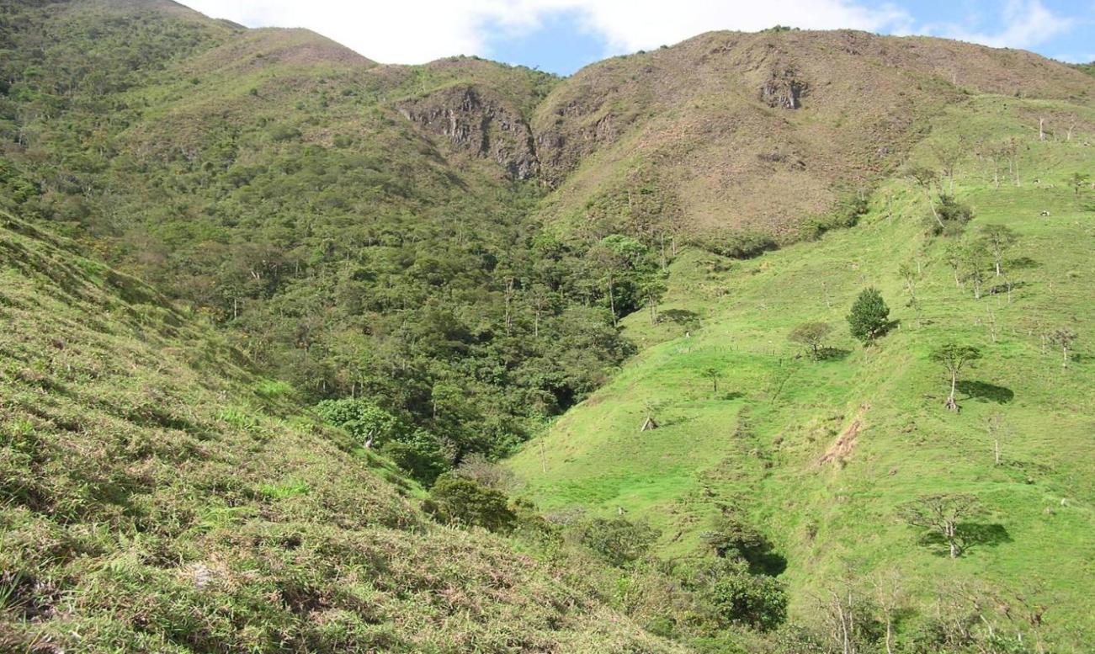
L'utilisation du sol (US): la perturbation /la récupération
Le reboisement peut-il rétablir le fonctionnement hydrologique des terres dégradées?
Savoka
perturbation
perturbation
Etat d'origine
Forêt
Récupération??
Tany Maty
From: H. Elsenbeer
Notes:
Land use changes quickly in many areas of the world: Forest is cut and burned for agriculture, after several tavy cycles the land is depleted and rice yieldds have gone down. After abandonment, shrubs and trees return slowly to the degraded land. Active replanting can similarly result in reforestation.
The question is whether natural regeneration or reforestation of degraded sites can also restore the hydrological functioning of degraded land and how this affects the amount of streamflow? We have very little scientific data to answer this question

Slide 10
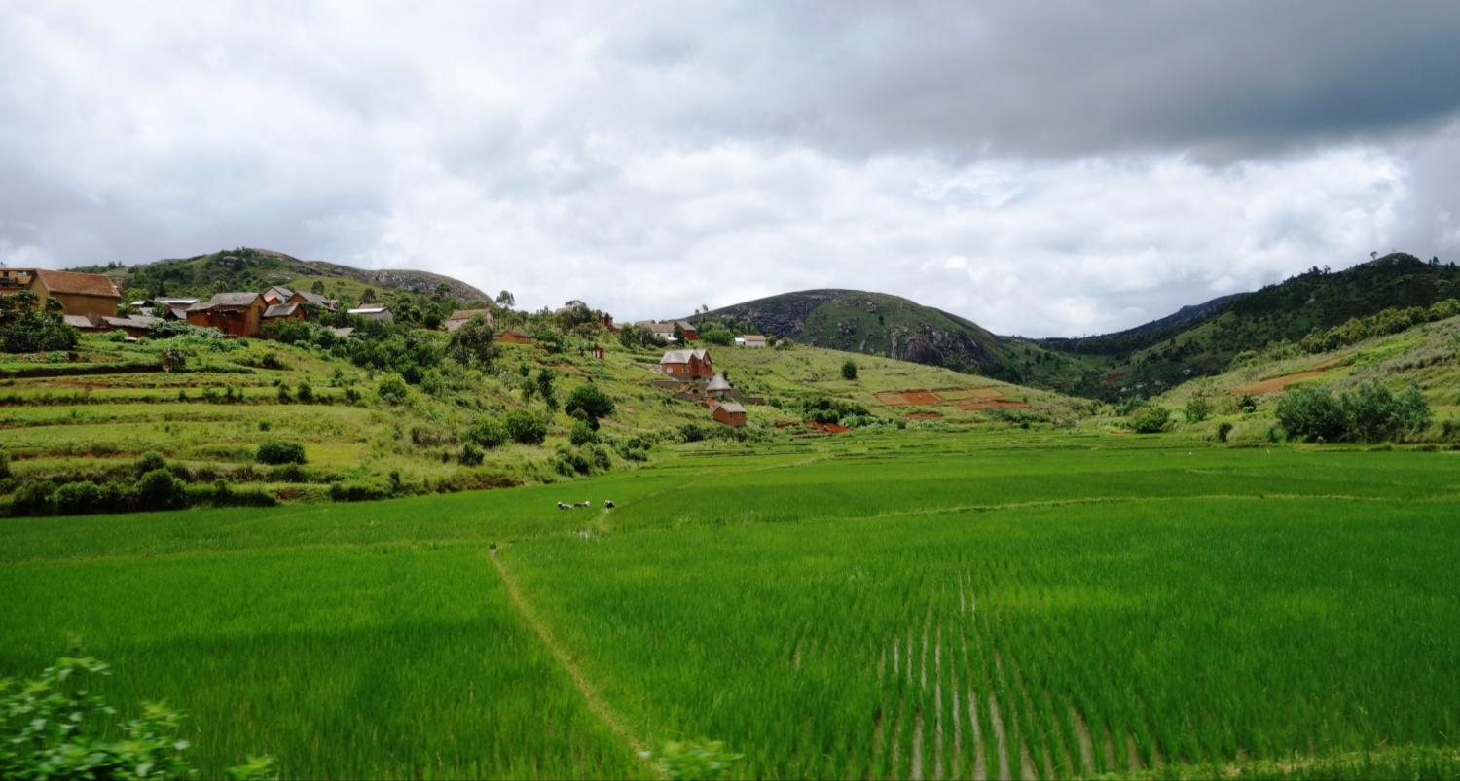
L‘US affecte l'approvisionnement d’eau au niveau local et régional
Ce qui se passe en amont..
…affecte ce qui se passe en aval
Notes:
Land use affects the amount of water, particularly streamflow, that is available for growing crops. What happens on the hills affects the lowland areas

Slide 11
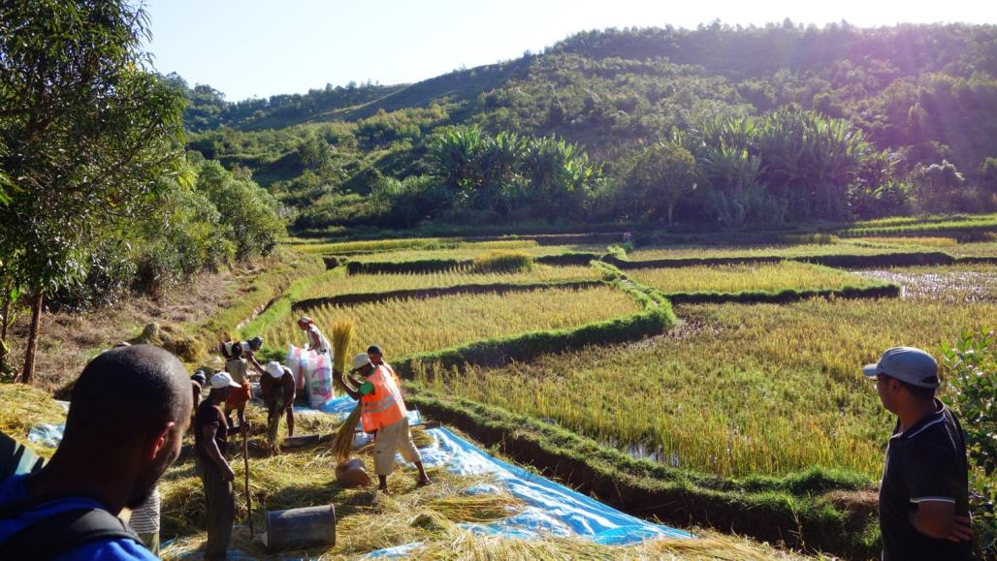
L‘US affecte l'approvisionnement d’eau locale et régionale
Trop d'eau lors de précipitations: inondations et des pertes de cultures
Trop peu d'eau pendant les périodes sèches: Rizières mal irriguées et donc réduction de la production rizicole
Notes:
Land use affects the amount of water in the streams,
If there is too much water going to downhill areas, this leads to flooding and the loss of crops. If there is too little water, then there is not enough water for irrigation and rice production
Too much and too little water both affect livelihoods.

Slide 12











L’US affecte la quantité du cours d’eau et le temps d’écoulement
Forêt
Tany Maty
?
?
Notes:
Generally there is less surface runoff in forest than in degraded land (red arrow). However, there is also more evapotranspiration (green arrow) so that the net effect on streamflow is unknown (purple arrows and question mark)

Slide 13
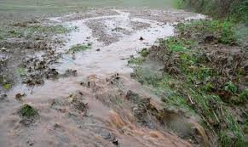



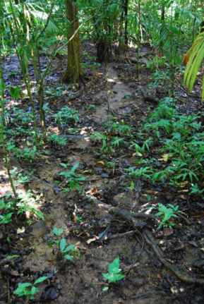

Peu de ruissellement en surface dans la forêt mais beaucoup dans le sol dégradé
  Degradation se traduit par l’entassement du sol, moins de MO, moins d’activités biologiques, ce qui entraine en même temps une faible capacité d’infiltration et plus de ruissellement.
?

Slide 14




L’US affecte la quantité de l’eau de rivière et le temps d’écoulement
Effets du changement de l’US comme tavy:
  Grande quantité de ruissellement entraîne le pic de débit durant la forte précipitation
  Grande quantité de ruissellement entraîne plus d’érosion et perte de fertilité du sol
  La faible capacité d’infiltration du sol conduit à la faible retention d’eau dans le sol et faible débit du cours d’eau pendant la saison sèche.
?
Notes:
Degradation leads to compaction of the soil, less soil organic matter, less soil biodiversity, which results in lower infiltration rates and more surface runoff. Surface runoff results higher streamflow peaks, as well as soil erosion and loss of fertile soil. When more water flows over the surface, less water infiltrates into the soil so that there is less water available for crops and streamflow during dry periods

Slide 15
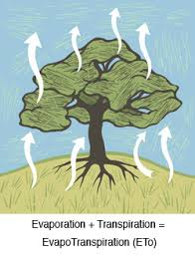




L’US affecte la quantité du cours d’eau et le temps d’écoulement
US affecte la quantité d’eau évaporée
  Les arbres, surtout les jeunes arbres enregistrent plus d’evapotranspiration et donc moins d’eau de ruissellement
?
Notes:
Trees / forests have greater leaf area and deeper roots, reflect less radiation, and have higher aerodynamic roughness than crops or grasses, resulting in higher evapotranspiration rates from forests than from crops or grasslands. This higher evapotranspiration rate, leads to less water for streamflow

Slide 16
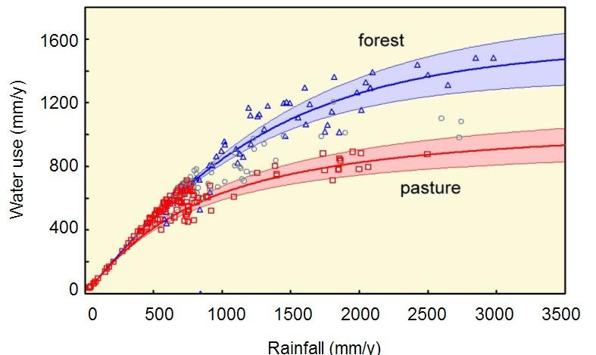
La quantité d’eau utilisée par les arbres est supérieure à celle du terrain de cultures ou en friche
  Trees / forests have greater leaf area, deeper roots, lower albedo, and higher aerodynamic roughness than crops or grasses
?
Andasibe

Slide 17
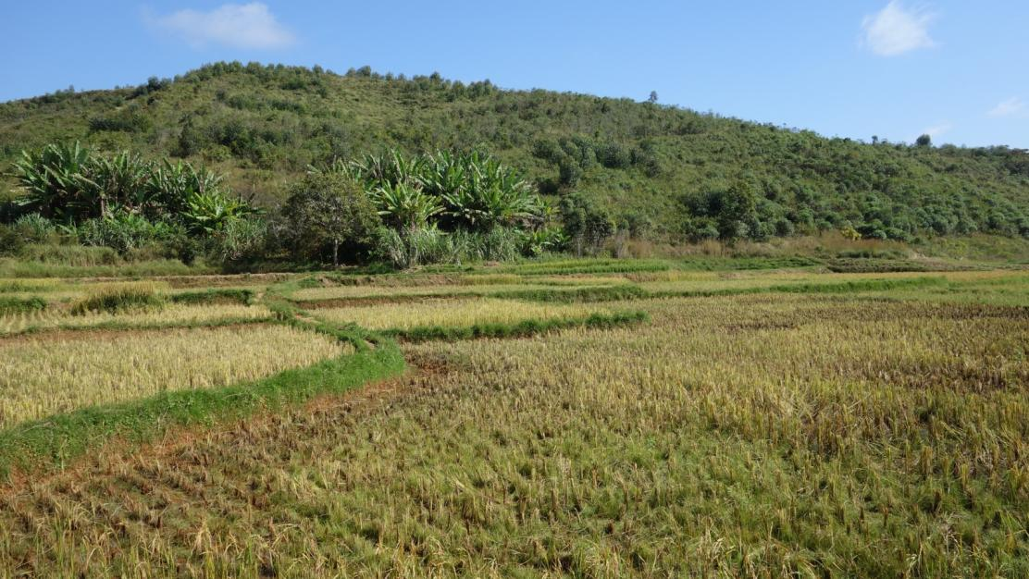
L’US affecte la quantité du cours d’eau et le temps d’écoulement
Les effets nets de l’US sur le débit de cours d’eau restent encore obscurs, ce qui est l’objet même de la recherche.
Notes:
Land use thus affects the amount of surface runoff and infiltration, and the amount of evapotranspiration. The net effect of these changes on streamflow during dry periods is poorly documented and largely unknown. This is therefore the subject of our research

Slide 18
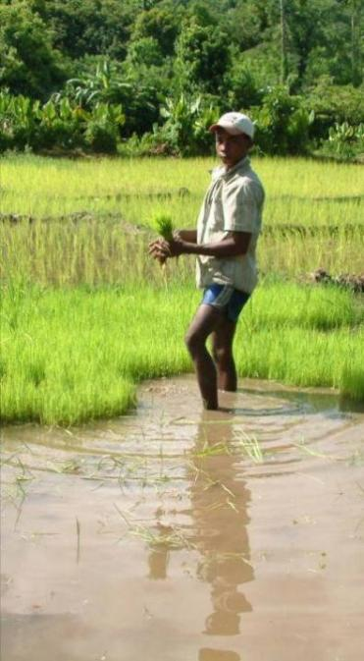
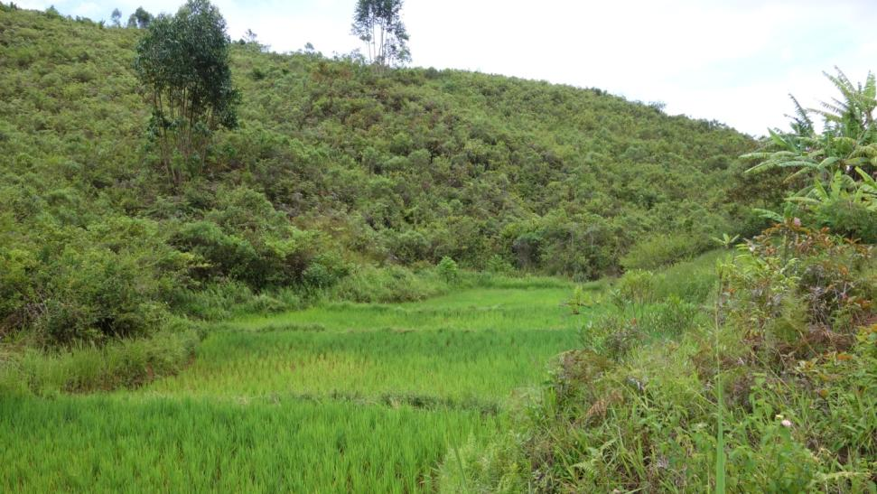
Recherche hydrologique: Objectif
Déterminer les impacts hydrologiques du changement de l’utilisation du sol au bénéfice de l‘application de l‘outil PSE
Local and regional impacts
Notes:
Hydrological processes have the potential to impact local livelihoods in many ways. We choose to focus on a specific service of particular importance in subsistence farming communities at the forest/agricultural margin: that of dry-season flows. PES schemes are often based on the perception that trees and forests always have positive hydrological impacts, rather than on a clear understanding of science-based forest-water linkages. The interaction between the positive and negative hydrological effects of forests is poorly understood, especially at the scales relevant to land-use policy. Because forests tend to have higher water use than rainfed agriculture in most contexts, dry-season streamflow after reforestation is only improved if the gains from enhanced infiltration under trees exceed the losses from increased evapotranspiration. The ultimate aim of this work is to investigate which interventions to increase forest cover will increase dry-season flows to such an extent as to have a significant positive impact on the local economy (e.g. enabling farmers to harvest a second rice crop).

Slide 19

Recherche hydrologique: Hypothèses
Sol degradé entraîne plus d’écoulement en surface, un pic de débit lors d’une intense précipitation et un faible débit pendant la saison sèche
La tendance peut être inverse dans la réforestation et/ou savomody
Notes:
Generally water flows more easily into forest soil than in degraded soil so that there is less surface runoff in forest than in degraded land (red arrow). However, there is also more evapotranspiration from forest than from crop and grass land (green arrow) so that the net effect on streamflow is unknown (purple arrows). We hypothesize that land degradation leads to higher streamflow peaks and less water in the dry season. We also hypothesize that reforestation can reverse the changes due to land degradation and thus restoration of the hydrological functioning.

Slide 20
Recherche hydrologique : questions clés
Les effets de l’utilisation du sol sur le processus hydrologique:
  Infiltration, structure du sol, voie préférentielle de l’eau
  Quantité l’eau de ruissellement en surface et subsurface
  Evapotranspiration (transpiration, interception)
  Cours d’eau
Notes:
Our key research questions are:

Slide 21
Recherche hydrologique
Infiltration et caractérisation du sol dans le CAZ ( 3 ZOI)
Trois sites d’expérimentation autour d’Andasibe
Etude des bassins versants autour d’Andasibe (Marolaona dans les années 70)
Notes:
The hydrology work of p4ges consists of 4 different components
Soil characterization at many different sites
Detailed measurements at 3 sites (forest, reforested, agriculture)
Detailed measurements at catchment that was studied in the late 1960s and early 1970s by Baily et al (1974)
Modelling
the first 3 components will provide part of the data for the modeling
The work of WP 2 will result in a unique set of measurements at the plot and watershed scales to determine the effects of widely occurring, but poorly researched, tropical land-cover changes on soil physical characteristics, the partitioning of precipitation into surface and subsurface flowpaths, and transpiration and interception losses. To date, no study has determined how interception and transpiration losses change over time with tropical forest regrowth. These data will be used to further develop and validate the WaterWorld hydrological model), which is widely used in conservation and international development decision-making but which, like many models, is not validated for many of the sites it is applied to.

Slide 22
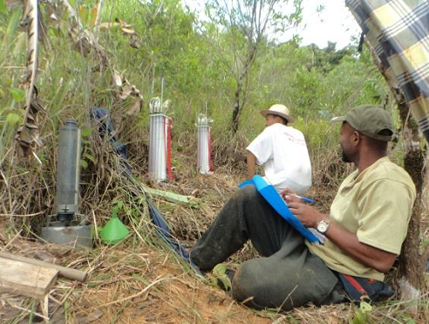
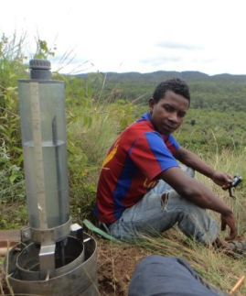
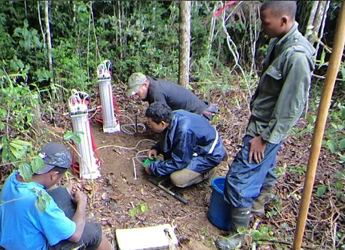
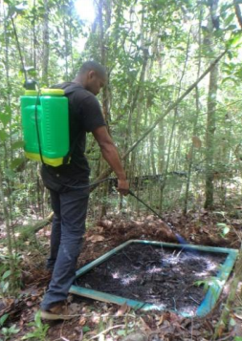
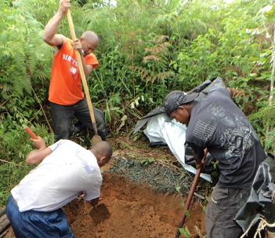
Que faisons-nous (I):
Trois zones d’intérêt dans le CAZ
On détermine
Propriétés du sol
Taux d’infiltration du sol (3 profondeurs)
Voie préférentielle de l’eau

Slide 23
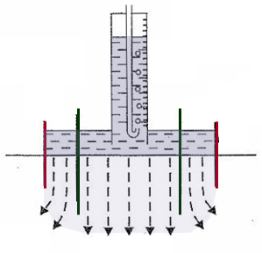
Mesures d’infiltration du sol
Mesures de l’infiltration du sol en surface (0-10 cm) et en profondeur (10-20 et 20-30 cm) selon les intervalles de temps détérminés

Slide 24
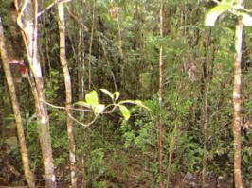
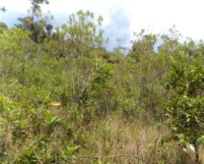
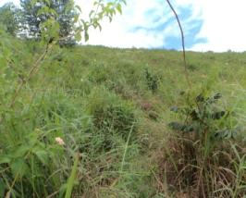

Résultats préliminaires
Capacité d’infiltration
CC
RF
SA
TM
Notes:
Our results show that the infiltrability is largest for closed canopy and smallest for tany maty. This means that water flows most easily and quickly into the soil in the forest sites and least quickly into the soil in the tany maty.

Slide 25
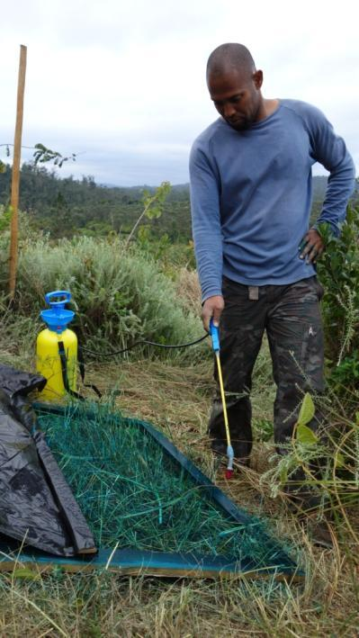
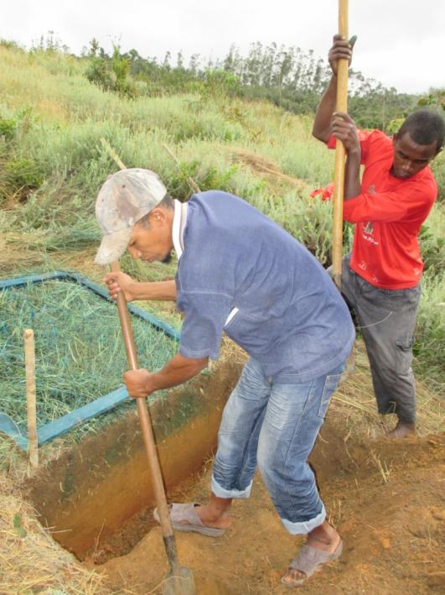
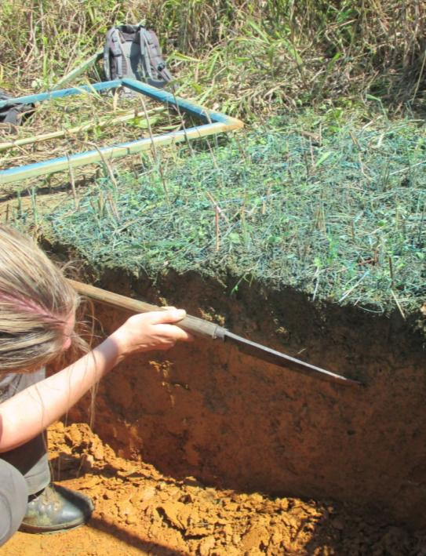
Blue dye experiment
Pour déterminer comment l’eau s’écoule dans le sol
Notes:
We also perform blue dye experiments to simulate how the water flows through the soil. We first spray a food-color (non-toxic dye) on the surface and then carefully dig a soil pit

Slide 26
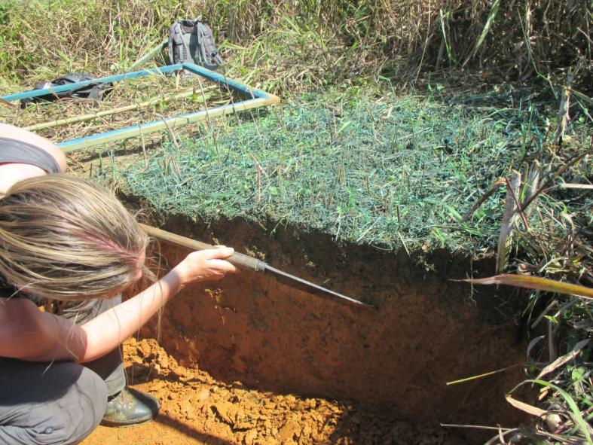
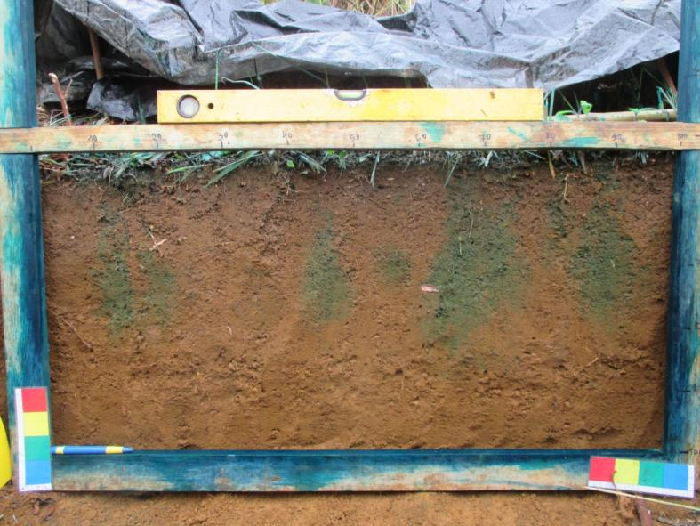
Blue dye experiment
Pour déterminer comment l’eau s’écoule dans le sol
Notes:
We then look at the pattern of the dye in the soil. Here we see that the dye has mainly flowed along roots into the soil

Slide 27
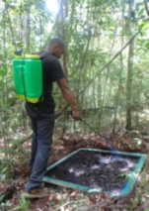
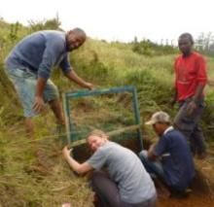

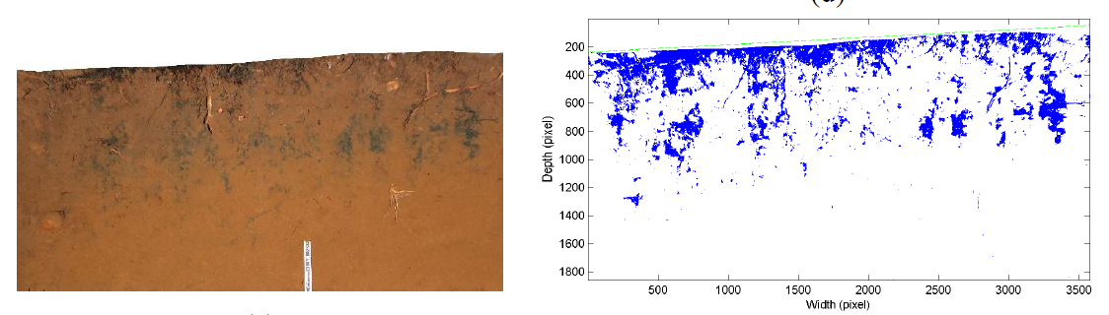

Résultats préliminaires
Blue dye experiments
ALM-RF1
AMT-TM
Ruissellement lors des pluies
Notes:
Our results show a different pattern of how water flows through the soil for forest and tany maty. In tany maty, water fills up the top 20 cm while in forest it can flow along roots deeper into the soil

Slide 28




Que faisons-nous? (II):
Trois sites (forêt, savoka arborée et tany maty) d’expérimentation:
Flux hydrologiques (précipitation, interception, transpiration, ruissellement de surface)
Changement de l’humidité du sol et l’eau dans la nappe groundwater
Notes:
In addition to the infiltration measurements, we have installed three runoff plots where we take continuous measurements for a year. We will visit one of these sites, the tany maty site, after this presentation

Slide 29

Weather stations
Pour déterminer la quantité de l’évaporation et la quantité de la précipitation
Température et humidité relative
Les pluviomètres
Radiation
Panneau solaire
Logger de données d'enregistrement
Notes:
At each of the experimental plots, we have installed a weather station to determine the amount of evaporation and precipitation. Each weather station consists of the following sensors

Slide 30

Soil moisture sensors
Pour déterminer la variation de l’humidité du sol
Soil moisture sensors at different depths
Notes:
We also installed soil moisture sensors in the soil to determine how precipitation and evaporation affect the amount of water in the soil

Slide 31

Parcelle d’essai du bassin versant
Pour déterminer la quantité d’eau de ruissellement en surface
Notes:
At each experimental plot, we have also installed runoff plots to determine the amount of water that flows over the soil surface and thus does not infiltrate into the soil

Slide 32



Résultats préliminaires
Parcelle d’essai
Forêt
Savoka
Tany Maty
Notes:
The intial results show that there is more water flowing over the soil surface in the Tany Maty sites than in the tree savoka and forest site

Slide 33



Mesures additionnelles dans la forêt
Mesures de l’interception dans la forêt
Gouttière
Seaux
Notes:
In the forest, we also measure the amount of rain that falls below the tree canopy and thus how much water evaporates from the leaves, stems and branches before it hits the ground. We measure the rainfall below the canopy using gutters and raingauges (gouttière d‘écoulement qui collecte de l‘eau)

Slide 34

Résultats préliminaires:
Mesure d’interception
Notes:
The preliminary measurements show that only 90% of the precipitation reaches the soil surface. This means that 10% of the water that falls on the tree canopy is evaporated from the wet leaves and branches. The differences between the forest and the savoka site are small, except for small events

Slide 35


Mesures additionnelles dans la forêt
Sapflow sensors pour mesurer la quantité de transpiration
Flux de sève
Notes:
We also measure the amount of transpiration from the trees using sapflow sensors. These sensors measure the temperature difference in the tree stem, which is related to the velocity with which the water moves through the trees

Slide 36



Que faisons-nous? (III):
Bassin versant couvert de savoka en grande partie (31 ha)
Rehabilitation des petits barrage-déversoir et installation des mesures pluviomètriques
Mesure du débit du cours d’eau et de la qualité d’eau
Notes:
We furthermore measure streamflow and surface runoff in a 31 ha catchment. This catchment was already studies in the 1960s. Comparison of our measurements with the historic measurements will show if there have beeb any changes in the hydrological functioning of the catchment in the past 50 years.
[make sure to ask if anyone knows anything about the Baily study – does someone have the data?]

Slide 37

Résultats préliminaires: de la pluie au débit
Hyétogramme /hygrogramme

Slide 38
Conclusion
L’US influe l’écoulement du cours d’eau aussi bien au niveau local que régional
On collecte les données pour déterminer comment l’US influe sur l’infiltration, evapotranspiration, le ruissellement et l’écoulement
Résultats préliminaires assez significatifs
Résultats définitifs seront communiqués au Gouvernement, STD, aux acteurs intéressés et surtout aux populations locales pour une meilleure gestion pérenne du sol et de l’eau.
Notes:
Our conclusions area that:

Slide 39


Grand merci à Mitsinjo, à l’ équipe locale, à la communauté locale
Notes:
We couldn‘t do this work without the help of many people, in particular our local team and the valuable support of the mitsinsjo staff. Funding for this work is provided by espa

Slide 40
Visite sur le terrain
On va visiter le site “Tany Maty”
  Infiltration
  Profile du sol et carottage
  Parcelle d’essai de bassins versants
  Station météorologique
Notes:
We will now go to the tany maty research plots to visit some of the work that I have just shown. We will divide the group into 2 smaller groups and visit the following 4 stations

Slide 41
Visite sur terrain
Répartition des invités en deux groupes
Questions, remarques et commentaires sont les bienvenus
Repas à Mitsinjo après la visite
Bonne visite
Notes:
We will now go to the tany maty research plots to visit some of the work that I have just shown. We will divide the group into 2 smaller groups and visit the following 4 stations

